Slide 1
Meet with Your ACS Customer Service Team: International Coordinators
March 14th, 2025
Chicago, IL

Slide 2
Poll:
What State or Country did you travel from to be with us today?

Slide 3
Welcome and Introductions
Trauma Education Team Office Hours:
Saturday, March 15th, 2025
Location: Outside of the Continental Ballroom
Times:
8:30 – 10:15am
11:30 – 12:15pm
2:15 - 4:45pm
Trauma Education Team
Customer Support:
Glenda Hill, Program Coordinator
Neil Kato, Program Coordinator
Maria Molina, Program Coordinator
Ana Hernandez, International Program Coordinator
Ryan Francescatti, Manager
Business Operations:
Jack Daly, Business Administrator
Olivia Grierson, Program Manager
Technical Program Manager: Meghan Baker

Slide 4
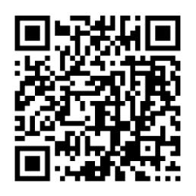
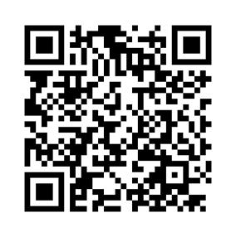
QR Codes:
Electronic Handouts for Sessions: Coordinator Questions for Sunday Session:

Slide 5
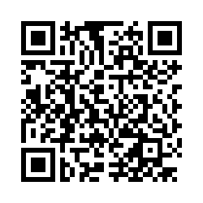
QR Codes:
ATLS 11 Launch Announcement - Pre-Registration:

Slide 6
Agenda
CMS and LMS: Meghan Baker
New Sites and Promulgation: Ana Hernandez
Ordering and Procurement Options: Jack Daly
Beyond ATLS: Ryan Francescatti & Olivia Grierson

Slide 7
CMS and LMS
Meghan Baker

Slide 8
Poll:
Do you use the Course Management System (CMS)?
1- Yes
2- No

Slide 9
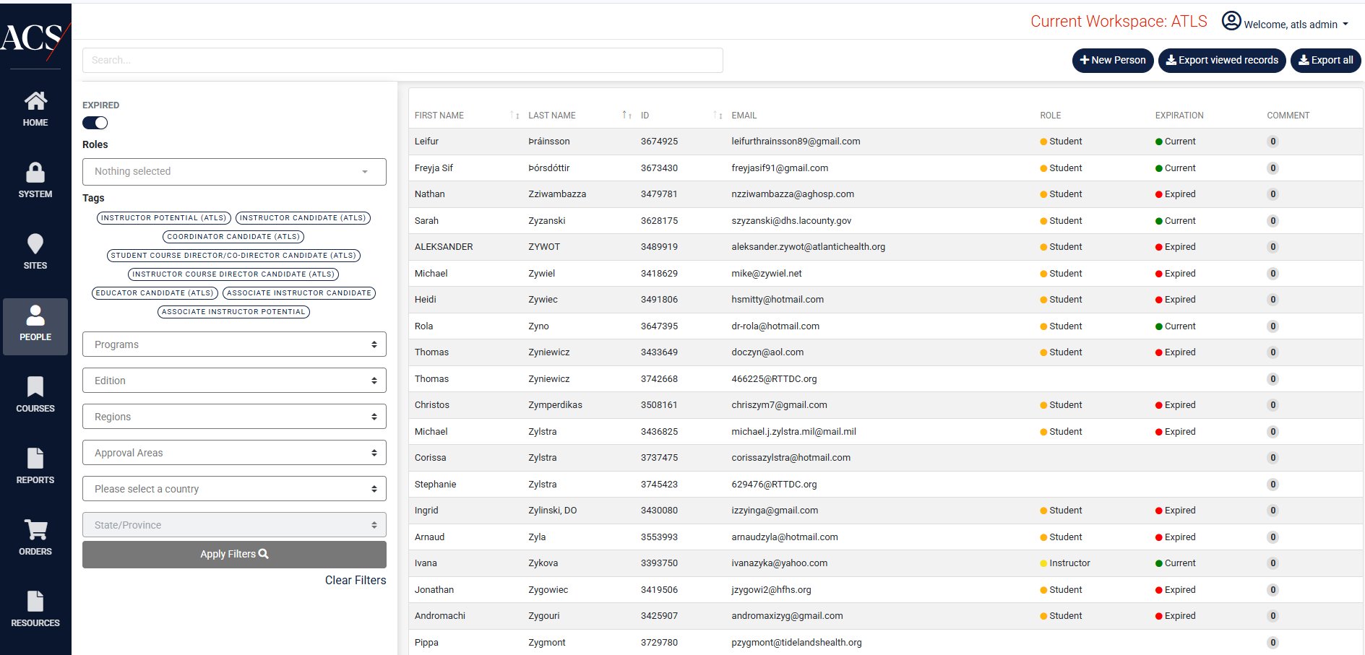
CMS
Course Management System, https://traumaed.facs.org/
Available to Coordinators, Faculty, Chairs and Region Chiefs
Used for: Course Administration, Access to Resources, Reporting Features and Purchasing Materials

Slide 10
New Features in CMS for ATLS 11th Ed.
Courses available in English, Spanish and Brazilian Portuguese at launch, with additional languages (as need identified) in the future
Course materials and emails will be in language selected for learners; course materials available in all languages for faculty
Sites can elect non-CME versions of each course type, minimizing required documentation (e.g., disclosures, financial reporting, etc.)
Ability to include appropriate Chair Name and Signature on ATLS cards for Countries with more than one contracting entity
Addition of Pre-Test data in CMS (transmitted data from LMS), including reports by site, course, region, country, state/province/ and date range
New report available to Chairs, Vice Chairs and Coordinators at course site level that includes all courses with faculty and student roster and email address

Slide 11
Current Benefits of CMS
Reporting Features:
Locate sites, faculty, coordinators, educators, etc. And contact information
Analyze data by course within sites, areas and/or regions
Access to course evaluation responses
Portable access to the most up to date course resources
Automatic emails to faculty and learners at different states with deadlines, prompts, reminders to ease administration of offering course
Enhanced learner experience and access to resources indefinitely for current edition (modules, etc.)
Access to LMS with PDF versions of Manual – lower cost due to no shipping, less delay of materials

Slide 12
LMS: Learning Management System https://learning.facs.org/
For Learners to access course materials and claim credit
ATLS 11th edition materials will be in language selected for course

Slide 13
New Sites/ Promulgation
Ana Hernandez

Slide 14
Poll: Are you considering seeking approval for a new ATLS site? 1. Yes – It's in the works. 2. Maybe – We are considering. 3. No thanks.

Slide 15
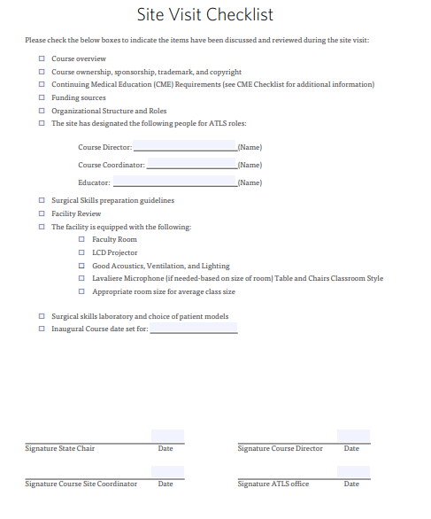
New Sites
During the ATLS site visit, the following items must be discussed and reviewed:
1. Course overview
2. Course ownership, sponsorship, trademark, and copyright
3. Continuing Medical Education (CME) in the U.S. and Canada
4. Funding sources in the U.S. and Canada
5. Organizational structure and roles
6. Surgical skills
7. Facility review
8. Surgical skills laboratory and choice of patient models
Notes:
Adjust time spent depending on response to previous question. If just a few people, go through quickly and offer for people to find you later. If a few dozen, spend more time!

Slide 16
Promulgation
ATLS
> 3000 courses/year
> 50k learners/year
> 80 countries
40% of courses from Regions 14-17

Slide 17
Promulgation
ATLS promulgation requests must be submitted by an approved entity such as:
Specialty Society
ACS Chapter
Ministry of Health

Slide 18
Promulgation
Full promulgation
ATLS program established in a new country for ongoing courses
Requires:
Application
COT Review
Site Visit/Approval
Initial Training
Inaugural Courses
Partnership Promulgation
For countries currently unable to develop an independent program
Establish a formal relationship with a sponsoring country
Sponsoring country responsible for oversight and conducting ATLS courses.
Partner country responsible for the site and the students/providers.
Effective for providing ATLS courses to countries with limited resources or limited people to train.
Goal is to transition to full promulgation within 3 years

Slide 19
Host Course
An ATLS host(Demo) course is a one-time course held outside of an approved, established facility or promulgated country to educate and train a cadre of physicians who do not normally have access to ATLS courses.
A host course can work to establish a network with which to build the proper resources to promulgate at a later date (either as a partnership or full promulgation).
Host courses must be preapproved by the ATLS committee prior to any planning. The requesting country is fully dependent on international faculty members for the coordination, logistics, and conduct of the course.

Slide 20
Host Course
Mexico & U.S.: Host Guatemala
Curaçao: Host Surinam
Fargo, ND: Host Kosova
Forthcoming:
Toledo, OH : Nepal
Pictured: Sanford Fargo, ND. team and Kosova

Slide 21
Orders & Procurement Options
Jack Daly

Slide 22
Introduction
Trauma Education Business Operations Team
Jack Daly (Me) – Business Administrator
Olivia Grierson – Program Manager

Slide 23
Projects/Responsibilities
Accounting/Finance
Operations
Bulk Orders
MAs/CLAs
Technical Issues
Vendor Management
Shipping
MyATLS App

Slide 24
Bulk Orders
Over 100 Items
Freight Shipping
Clutch/Get Logistics
Options
CMS
Order Form

Slide 25
Bulk Orders - CMS

Slide 26
Order Received in
CMS
Freight Shipping
Quote
Invoice Sent to Customer for Payment
Shipping Cost Added to
Invoice
Invoice Paid and Order Shipped
Customer Receives
Order

Slide 27
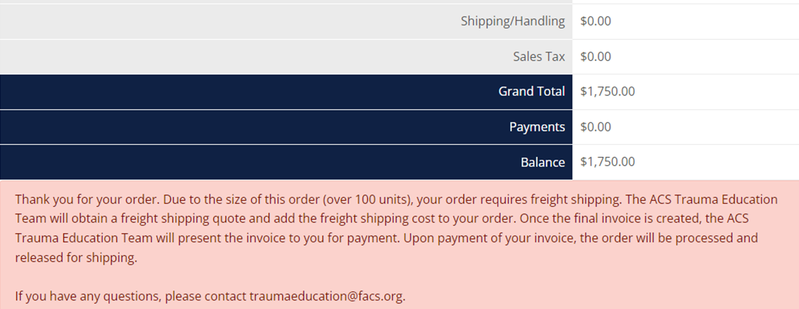

Slide 28
Bulk Orders – Order Form

Slide 29
Customer Completes Order Form
Order Form Sent to Trauma Education
Invoice Sent to Customer for Payment
Invoice Created with Freight Shipping Cost
Invoice Paid and Order Shipped
Customer Receives
Order

Slide 31
Procurement Options

Slide 32
Hard Copy/Physical Manual
Physical Manual for Students
Cost of Shipping
Customs Import/VAT Tax

Slide 33
PDF/LMS Version of Manual
Customs Import/VAT Tax May Not Apply
No Shipping Cost
No Physical Manual
Access to Computer

Slide 34
Print in Country
Access to Printer
No Shipping Cost
Customs Import/VAT Tax May Not Apply
$10.00 Discount per Manual

Slide 35
Beyond ATLS
Ryan Francescatti & Olivia Grierson

Slide 36
ATOM: Advanced Trauma Operative Management
Increases surgical competence and confidence by teaching proper operative techniques for penetrating injuries to the chest and the abdomen.
Intended for senior surgical residents, trauma fellows, military surgeons and general surgeons not frequently called on to treat penetrating injuries.
Currently in its 3rd Edition.
Available on Trauma Education's Course Management System (CMS).
ATOM Chair: Paul Engels, MD, FACS

Slide 37
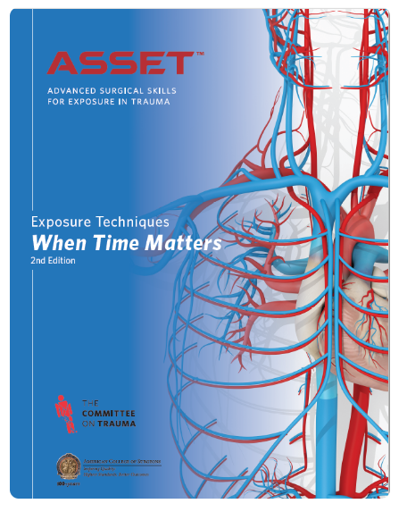
ASSET: Advanced Surgical Skills for Exposure in Trauma
Teaches students how to surgically expose threatening injuries.
Includes the use of a human cadaver.
Extremely interactive as participants learn how to assess and expose injuries that may threaten a life of limb.
Low student-to-faculty ratio allows for extensive faculty guidance.
Currently in its 2nd Edition.
Available on Trauma Education's Course Management System (CMS).
ASSET Chair: Daniel Grabo, MD, FACS

Slide 38
BEST: Basic Endovascular Skills for Trauma
Designed to teach basic endovascular techniques to trauma and acute care surgeons who have limited or no formal endovascular training.
Highlights skills needed for Resuscitative Endovascular Balloon Occlusion of the Aorta (REBOA).
Offered as a full course that includes cadaver work as well as a workshop that allows participants to practice with simulators.
Currently in Edition 2.1
Not currently available on Trauma Education's Course Management System (CMS).
BEST Chair: Megan Brenner, MD, FACS

Slide 39
RTTDC: Rural Trauma Team Development Course
Has been developed to improve the quality of care in rural communities by developing a timely, organized and systemic response to care of the trauma patient.
The course emphasizes a team approach and focuses on common problems in the initial assessment and stabilization of the patient.
RTTDC teaches rural facilities how to apply the principles of ATLS using their own people, equipment and resources.
Currently in its 4th Edition.
Available on Trauma Education's Course Management System (CMS)
RTTDC Chair: Dr. Person,
No

Slide 40
DMEP: Disaster Management and Emergency Preparedness
Teaches planning methods, preparedness and medical management of trauma patients in mass casualty disaster situations.
Helps organizations be better prepared for a mass casualty event.
Combines lecture and interactive scenarios.
Open to anyone who may be a first receiver of casualties following a disaster.
Currently in its 2nd Edition.
Not currently available on Trauma Education's Course Management System (CMS)
DMEP Chair: Jeannette Capella, MD, MEd, FACS

Slide 41
TEAM 4th edition
Course overview
TEAM (Trauma Evaluation and Management) 4th Edition is an introductory course to trauma principals. This course is meant to teach multidisciplinary healthcare professionals how to evaluate and manage a trauma patient. TEAM is offered in English and Spanish, with forthcoming French and Brazilian Portuguese versions.

Slide 42
TEAM 4th edition
Course objectives
Explain fundamental principles of initial assessment and management of trauma patients
Highlight the correct sequence of priorities using the xABCDE algorithm (Exsanguinating External Hemorrhage, Airway, Breathing, Circulation, Disability, Environment/Exposure)
Discuss guidelines and techniques used during the initial resuscitation and definitive care phases of care
Describe how a patient's medical history and mechanism of injury can contribute to the identification of injuries
Outline roles and responsibilities of team members and discuss TEAM related concepts that ensure optimal care of injured patients
Identify which patients may need early interhospital transfer
Analyze strategies for injury prevention

Slide 43
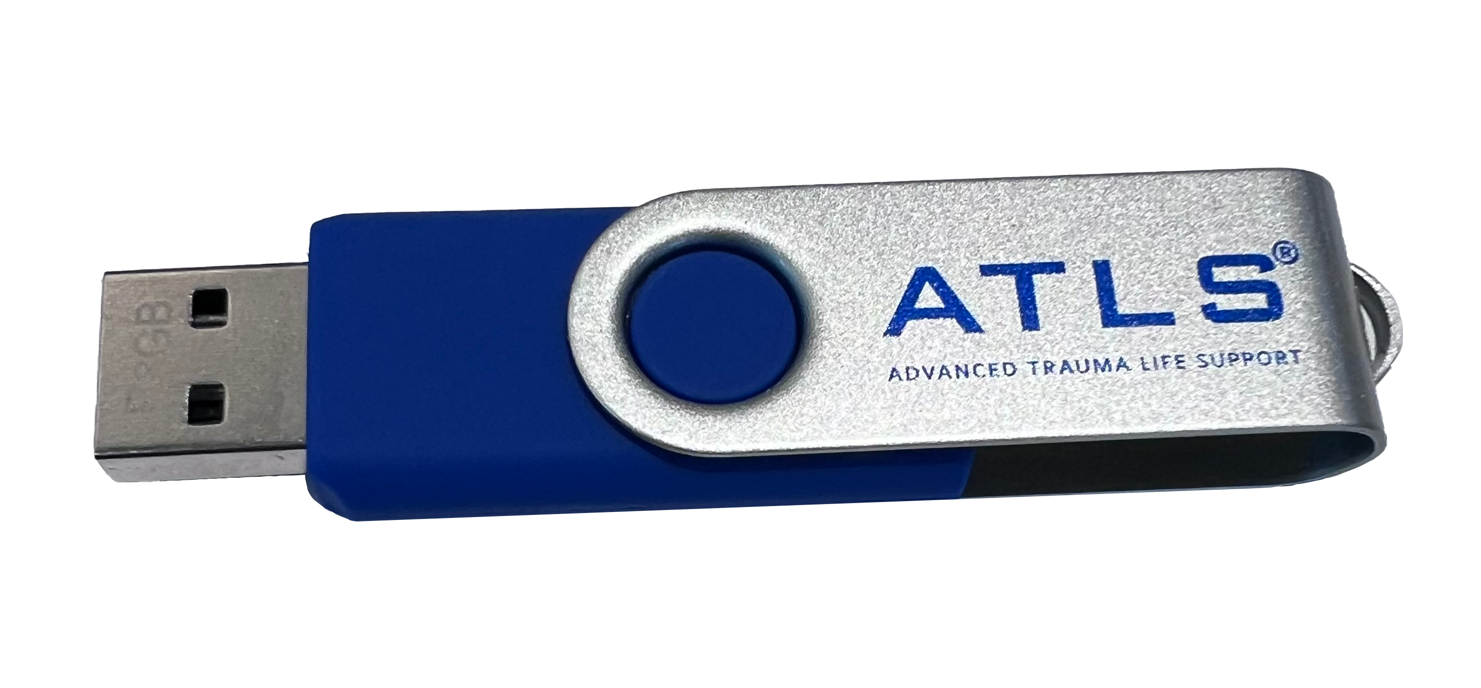
Trauma Education
AVAILABLE FOR PURCHASE
Types of Courses Offered
COMMITTEE ON TRAUMA
English | Spanish
$35
$5
New price!
10th Edition
4th Edition
3rd Edition
2nd Edition

Slide 44
Trauma Education Online Courses:
Advanced Medical Disaster Response (ADMR)
Online training program specifically designed for current, future or interested disaster responders and support groups.
Modules topics include Mass Casualty Incident Management, Disaster Medical Triage, Incident Command System and more.
electronic Disaster Management Emergency Preparedness (eDMEP)
Provides learners with a scenario to practice disaster management principles in a low-stakes virtual environment.
Fundamentals in the Management of Traumatic Brain Injury (TBI)
Joint Initiative of the Brain Trauma Foundation and the ACS Committee on Trauma.
Will be of interest to all clinicians who care for trauma patients, providing learners with current best evidence practices for patients with severe TBI.

Slide 45
Questions?

