Slide 1
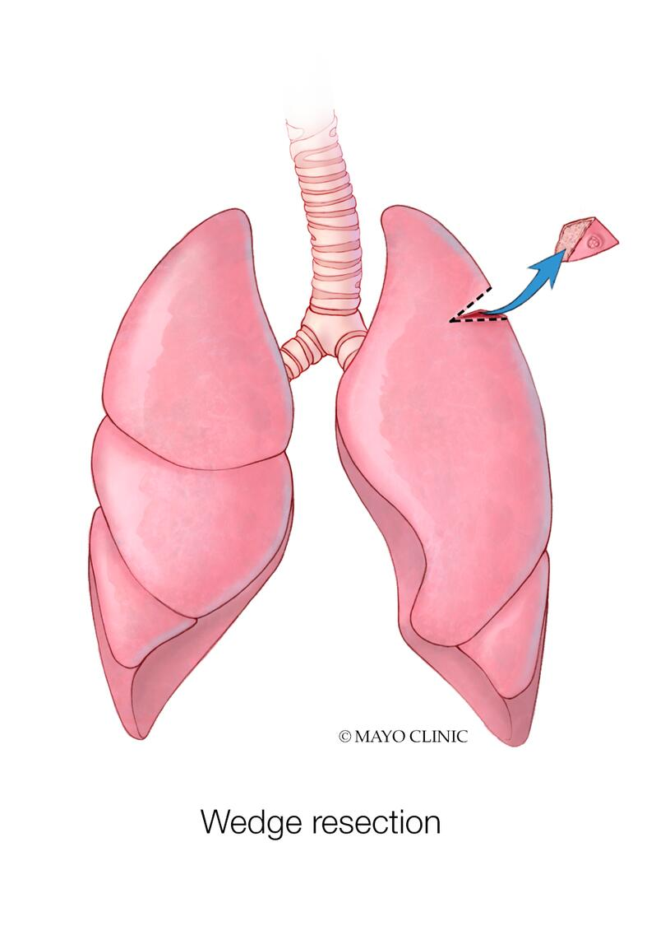
Volume Isn’t What It Used to Be: Reconsidering the Minimum Case Volume Threshold for Lung Cancer Resection
Mohamed Aly MD, Safwan Abbasi MD, Chee-Chee Stucky MD, Zhi Ven Fong MD, Dawn Jaroszewski MD MBA, Yu-Hui Chang PhD, Nabil Wasif MD MPH
Department of Surgery
Division of Surgical Oncology
Mayo Clinic Arizona

Slide 2
No conflicts of interest to declare
Disclosures

Slide 3
Leapfrog Group
Founded in 2000 by Business Roundtable, RWJF and the Commonwealth Fund
Non-profit organization to improve quality and safety of US healthcare system
Collect, analyze and publish data on safety and quality
©2023 Mayo Foundation for Medical Education and Research | slide-3

Slide 4
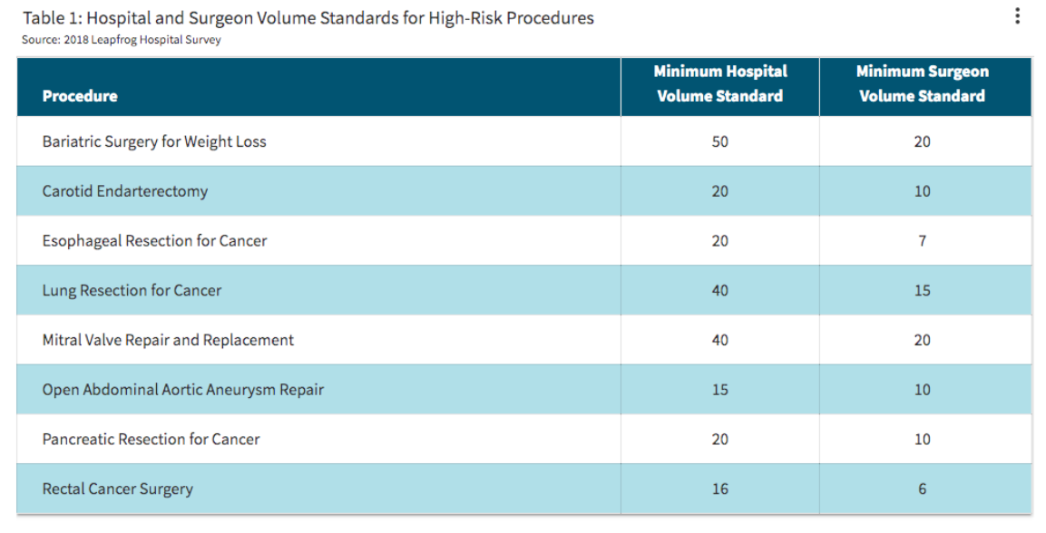
Leapfrog Volume Standards
©2023 Mayo Foundation for Medical Education and Research | slide-4

Slide 5
Current recommended minimum hospital volume standards for lung cancer resection (≥40) do not apply to contemporary practice
Hypothesis

Slide 6
Data Source
National Cancer Database (NCDB)
Patients undergoing curative surgery for lung cancer
2015-2019
Hospitals classified as above or below recommended volume thresholds

Slide 7
Inclusion/Exclusion Criteria
NCDB lung cancer
2015 -2019
(N = 837,289)
Exclude:
- Patients whose initial diagnosis was not made
- Patients who were not treated at the reporting facility
- Patients with stage IV cancer
Include:
- Patients who underwent curative intent surgery
NCDB lung cancer
2015 -2019
(N = 171,194)
Exclude:
- Patients treated at facilities without consecutive reporting for 2015-2016
NCDB lung cancer
2015 -2019
(N = 169,809)
Exclude:
- Patients with missing 30-d mortality
NCDB lung cancer analytic dataset
(N = 166,341)

Slide 8
Statistics
Reliability Adjustment
Account for low volume bias
Risk Adjustment
Case mix
Controlled for age, sex, race, insurance, income, stage, education, Charlson co-morbidity and surgery type

Slide 9
RESULTS
Total of 995 hospitals and 166,341 patients
26.8% of hospitals met the recommended minimum number of 40 for lung cancer resection
Of these, 55.7% were academic/research centers
Overall benchmark 30-day mortality was 1.8%

Slide 10
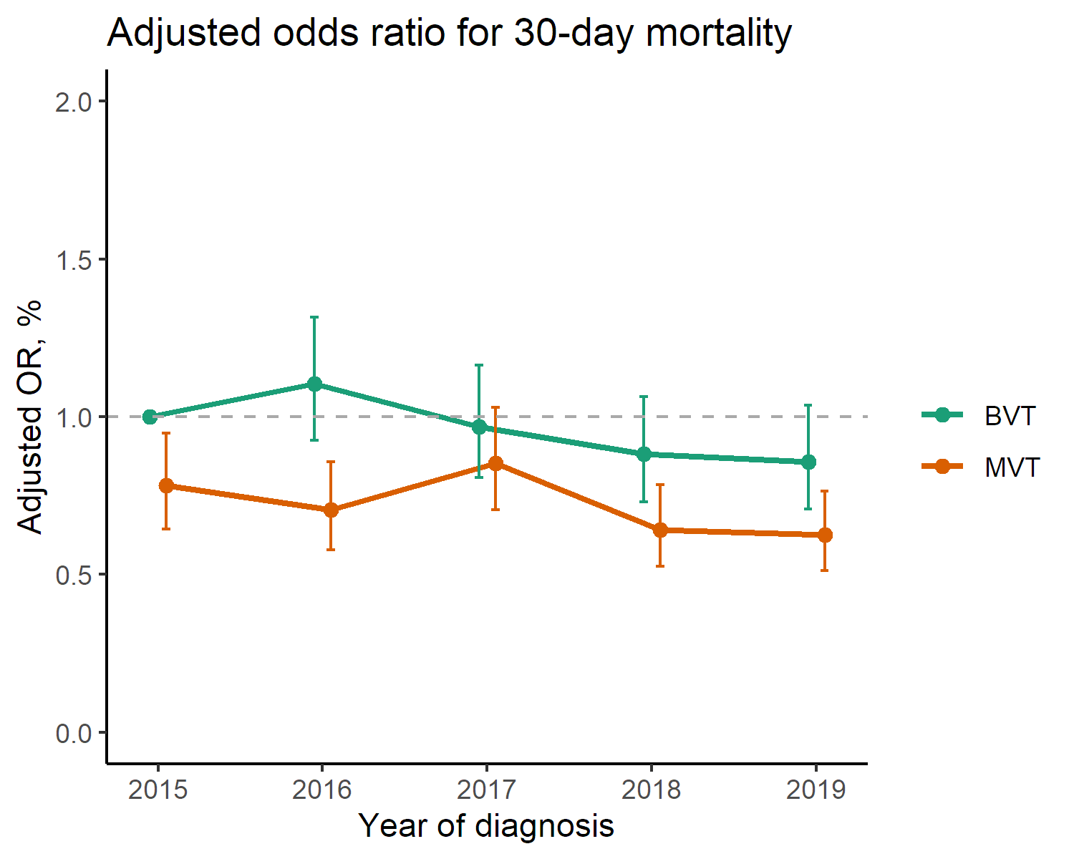
ADJUSTED 30-DAY MORTALITY
©2023 Mayo Foundation for Medical Education and Research | slide-10
Image copyright GettyImages

Slide 11
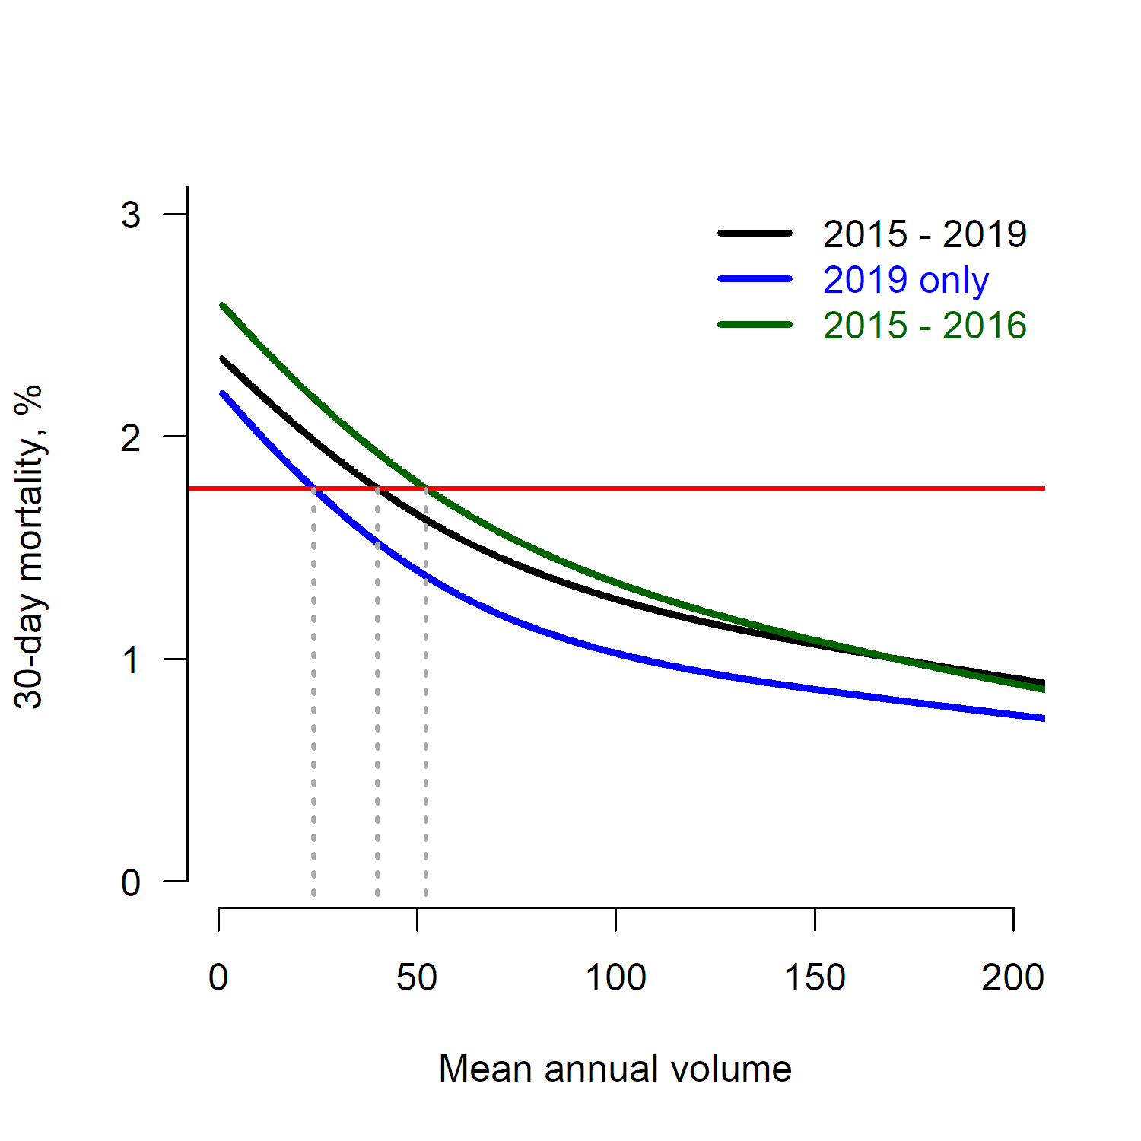
VOLUME OUTCOME
CURVE SHIFT
Red line- 1.8%
Benchmark 30day mortality for >40 cases 1.8%
Green line- 52.3
Cases needed to achieve 1.8% 30day mortality in 2015
Black line- 40
Cases needed to achieve 1.8% 30day mortality from 2015-2019
Blue line- 23.9
Cases needed to achieve 1.8% 30day mortality in 2019
Optional text here
©2023 Mayo Foundation for Medical Education and Research | slide-11
Image copyright Shutterstock

Slide 12
CONCLUSIONS
Only 26.8% of hospitals meet the recommended minimum number of 40 cases for lung cancer resection
30day mortality for lung cancer resection decreased from 2015-2019
Same benchmark mortality of 1.8% was achieved with 24 cases in 2019 vs. 52 cases in 2015
Lowering volume thresholds for lung cancer resection in contemporary practice should be considered

Slide 13
ACKNOWLEDGMENTS

