Slide 1
NCDB Vendor Webinar
Updates October 11, 2024

Slide 2
Topics to be Covered Today
Updates
2025 Layout
  File Extract Requirements, Layout and Edits
STORE 2025 Updates
  Removed data items
  New data items
  Changed data items
Standard 6.4
  NO Call for Data
Communication

Slide 3
RCRS File Extract Requirements
XML Version
v24 and v25 XML files supported
* v23 will retire Jan. 11, 2025; once v25 launched
Data
Data to include “I” Incident Fields and “A” type NPI data fields
NCDB Call for Data → No more Call for Data
Upload Restrictions
Each file contains only 1 unique FIN
For INCP Networks each file must be submitted at the child level
You must be an Uploader for the FIN in the file

Slide 4
V25 CoC Custom Dictionary Fields
Custom NPI fields in CoC Dictionary - No Changes
Would like to retire CoC custom dictionary

Slide 5
Meta File and Edit Scoring
Uploaded file scored twice
RCRS edit set – Must have a zero edit score for measure processing
NCDB edit set – Completed case record or zero edit score
Required for Submission Compliance Report
Metafile Edit Sets
Edit Scoring
Preliminary cases will be collected with an RCRS edit set score of 1 to 199
RCRS – Measure eligible if score is 0 and DX_YEAR > 2018
NCDB – No errors accepted (Call for Data/ Submission compliance)

Slide 6
New Edits
New edits and scores for v25
ID | Description | RCRS Score | NCDB Score
N0570 | RX Date Radiation, Rad--Regional RX Modality (NAACCR) | 0 | 1
N0589 | RX Date Rad Ended, Rad--Regional RX Modality (COC) | 0 | 1
N7085 | AJCC TNM P Stage, Appendix, Histologic Subtype (COC) | 0 | 1
N7110 | Date of Last Contact, Date of First Contact (NAACCR) | 0 | 200
N7127 | PD-L1, Date DX (NAACCR) | 0 | 1
N7128 | PD-L1, Schema ID, Required (NAACCR) | 0 | 1
N7142 | Chromosome 1p, Brain, Behavior (SEER) | 0 | 1
N7143 | Chromosome 19q, Brain, Behavior (SEER) | 0 | 1
N7144 | Methylation of O6-Methylguanine-Methyltransferase, Brain, Behavior (SEER) | 0 | 1
N7145 | Post Transplant Lymphoproliferative Disorder-PTLD, Date DX (NAACCR) | 0 | 1
N7146 | Post Transplant Lymphoproliferative Disorder-PTLD, Schema ID, Required (NAACCR) | 0 | 1
N7151 | SSDI BRAF, Blank for Other Schemas (NAACCR) | 0 | 1
N7155 | SSDI Chromosome 1p, Blank for Other Schemas (NAACCR) | 0 | 1
N7157 | SSDI for Pleural Mesothelioma, Blank for Other Schemas (NAACCR) | 0 | 1
N7163 | Date of Birth, Date of Last Contact (NAACCR) | 0 | 200

Slide 7
Removed Edits
Deleted edits for v25
Deleted ID | Edit Description
N2708 | Gleason Patterns Pathological, Date DX (NAACCR)
N7053 | Grade at Autopsy (NAACCR)
N7070 | Prostate, RX Summ--Surg Prim Site 2023, Histologic Type (NAACCR)
N7090 | Grade, Bladder, Morphology (SEER)
N7093 | Grade, Lymphoma/HemeRetic, Brain/CNS (NAACCR)
N0602 | RX Hosp--Surg Prim Site 03-2022, Primary Site, ICDO2 (COC)

Slide 8
V25 STORE Updates
New SSDI data items
1172 PTLD – Post transplant lymphoproliferative disorder
1174 PD-L1 - Lung
Removed data items
No Removed items

Slide 9
V25 STORE Updates
Please be sure to review the Summary of Changes section as STORE has been reviewed to arrange guidance information under coding guidance and removed old/outdated information. If you have any specific questions, please be sure to contact us.
Changed data items
  Behavior Code [523]
    Lobular neoplasia (C50. ) - Removed
    Lobular, noninfiltrating (C50. ) (carcinoma) - Removed
  Removed Blank from Allowable value box; coding guidelines require field
    Rx Hosp—Surg2023
    Rx Summ—Surg 2023
    Phase I Radiation - Primary Treatment Volume
    Phase I Radiation to Draining Lymph Nodes
    Phase I Radiation Treatment Modality
    Phase I Beam Radiation Planning Technique
    Phase I Dose per Fraction
    Phase I Total Dose
    AJCC TNM Clin Stage Group
    AJCC TNM Path Stage Group

Slide 10
V25 STORE Updates
Changed data items
  Lymphovascular Invasion LVI [1182] v9 Schema IDs
    09190
    09290
    09301
    09302
    09320
    09330
    09340
    09350
    09360
    09500
    09520
    00528 (was missing now added 2c)
  Readmission to Same Hospital within 30 Days of Surgical Discharged
    Removed outdated ICD 9 Code information

Slide 11
Standard 6.4
CoC Standards 6.4 requirements
  Submission Compliance Report
  90% Rule (prior 3 year analytic case load average)
  New Call for Data website name
  Performance reported at 2 Cancer Committee meetings yearly

Slide 12
2024 No Call for Data
No Annual Call for Data for analytic cases with diagnosis year 2023
  Open Window
            Submissions performed monthly through RCRS
            December 31, 2024 until 11:59pm CT
  All new and updated cases with diagnosis years back through and including 2009 should continue to be submitted monthly to RCRS
                If first accredited date is more recent that 2009, use the most recent date instead of 2009.

Slide 13
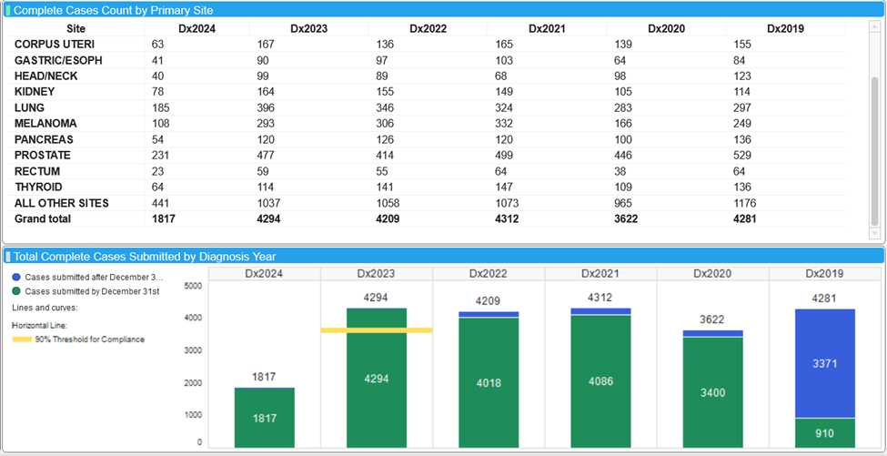
Reminder No 2025 Call for Data
  Cohort Completeness Report in RCRS has been removed
  Cohort Completeness report has evolved into the Submission Compliance Report, now in RCRS
Why the new process:
  This takes some pressure off software rollouts
  Enable NCDB to produce reports earlier in the year and with newer data
  Reduce redundancy and check box activities of the ODS

Slide 14
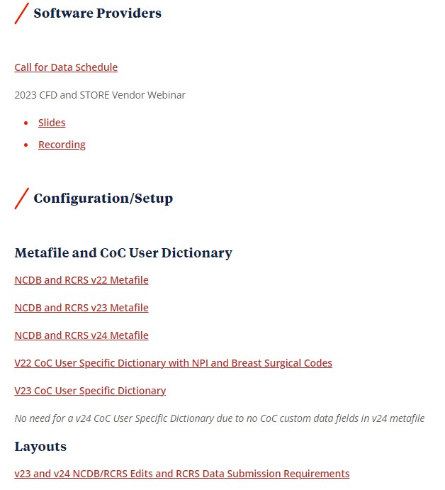

Communication and Resources
Cancer Program News
NCDB Call for Data website

Slide 15
Thank You
These slides will be distributed as well as a recording of this presentation. Thank you for all your work serving our mutual customers.
ncdb@facs.org

