Slide 1
COT Moving Forward
Jeffrey D. Kerby, MD, PhD, FACS
Chair, Committee on Trauma

Slide 2
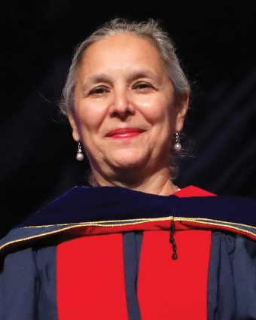
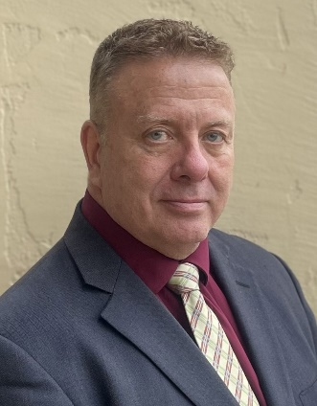
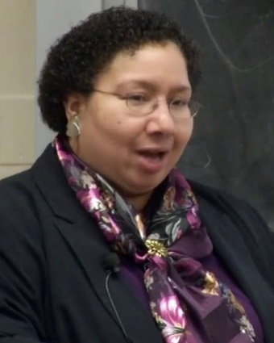
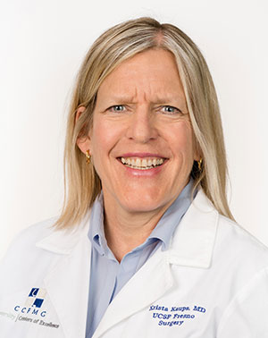
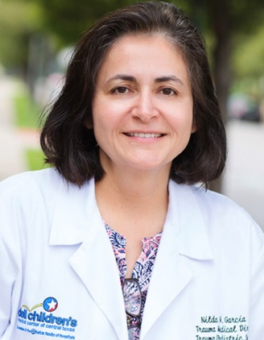
In Appreciation
Anne Rizzo, MD, FACS
Quality Pillar Chair
Brian Eastridge, MD, FACS
Trauma Systems Pillar Chair
Kimberly Joseph, MD, FACS
Education Pillar Chair
Krista Kaups, MD, FACS
Membership Chair
Nilda Garcia, MD, FACS
VRC Chair

Slide 3

COT Vision Statement
Eliminate preventable death and disabilities from traumatic injury across the globe…….

Slide 4
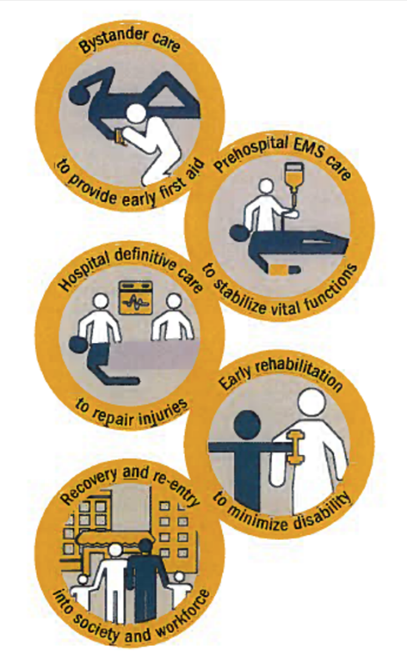
Continuum of Care
Injury Prevention Programs
Firearm Injury Prevention Coalition/FAST Team Workgroup
ISAVE Workgroup
Hospital Based Violence Intervention Programs
Trauma Informed Care
Disaster Management Courses (ADMR/DMEP)
STOP THE BLEED™ Training
EMS Field Triage Guidelines/EMS Position Statements
Prehospital Trauma Life Support Education
Trauma Center Standards/Verification Program
Trauma Quality Improvement Programs (TQIP)
Best Practices Guidelines/Trauma Guidelines Repository WG
Advanced Trauma Life Support (ATLS)
Surgical Skills Training
Trauma Systems Evaluation and Planning
Patient Reported/Long-Term Outcomes

Slide 5
COT Impact: By the Numbers
596 ACS Verified Trauma Centers
902 Trauma Centers in TQIP
70,000 learners impacted by Trauma Education
50 Trauma System Consultations
>3.75 million trained in STOP THE BLEED™

Slide 6
COT Priorities Moving Forward
Advocacy, Advocacy and Advocacy
National Trauma and Emergency Preparedness System
Strengthen COT Core Programs (Quality/Education)
Focus on Rural Trauma/Trauma Care in the Community
Injury Prevention with focus on Firearm Injury Prevention
COT Membership/Engagement Opportunities

Slide 7


Advocacy, Advocacy, and Advocacy
Federal
  Pandemic All Hazards Preparedness Act
    NTEPS – language around RMOCCs
    Mission Zero
  Prevent BLEEDing Act
  Comprehensive Universal Background Checks
  Bipartisan Solution to Cyclical Violence Act
  Medicare Physician Payment Cuts
State
  Stop the Bleed

Slide 8
Advantages of RMOCCs
Minimal “start-up” time for large-scale events because RMOCCs support daily operations which leads to….
Reduced friction at time of need
  Hospital level: May be easy to distribute patients in a single mass casualty event, but protracted scenarios require standing agreements between entities at the local, state, national levels
  Transport level: Coordinating movement of patients represents separate challenge involving personnel and equipment
  Supply level: Resource sharing may be optimal when patient redistribution less feasible

Slide 9
Regional Committees on Trauma (RCOT)
Warren C. Dorlac, MD, FACS

Slide 10
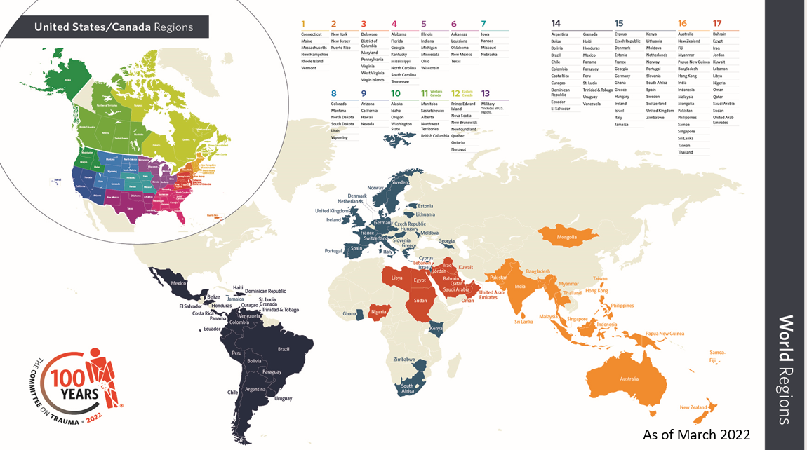
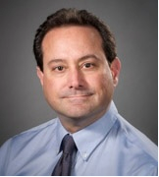
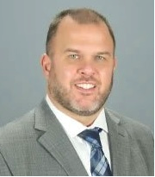
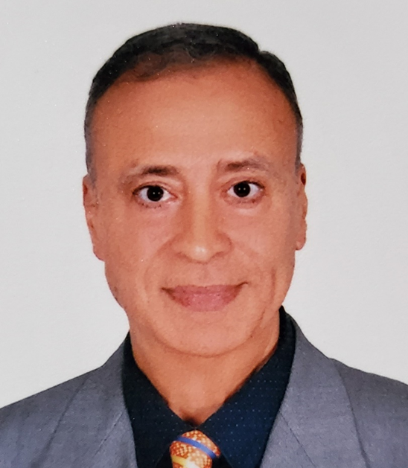
Welcome: New Region Chiefs
Region 2 – Matthew A. Bank (Flynn)
Region 8 – Michael A. Person (Dunn)
Region 17 – Abdelhakim T. Elkholy (Abi Saad)

Slide 11
Welcome: New State/Provincial/Country Chairs
Joaquín Bado (Uruguay)
Andrew C. Bernard (Kentucky)
Avi Bhavaraju (Arkansas )
Matthew J. Bradley (Navy)
Scott C. Brakenridge (Washington)
Dudley B (Benjie) Christie III, (Georgia)
Phil Dawe (Canadian Military)
Sean D. Dort (Nevada)
Marquinn Duke (Louisiana)
Raymond Fang (Maryland)
Peter E. Fischer (Tennessee)
Richard L. George (Ohio)
Laura N. Godat (San Diego)
Daniel J. Grabo Jr (West Virginia)
Michael P. Hogan (Newfoundland )
Felix Del Carmen Ramirez Ibarra (Argentina )
Dennis Y. Kim (British Columbia )
Richard J. Miskimins (New Mexico)
Alexis M. Moren (Oregon)
Jon Perlstein (Northern California)
William B. Perry (Veterans Administration)
Kartik Prabhakaran (Greater New York)
Rajesh R. Gandhi (Northern Texas)
Justin L. Regner (Southern TX)
Thomas J. Schroeppel (Colorado)
Erik W. Streib (Indiana)
Brian Thurston (South Carolina)
Denise M. Torres (Pennsylvania)
Eric A. Toschlog (North Carolina)
Elizabeth N. Turner (Maine)
Rodrigo Vaz Ferreira (Brazil)
Michael A. Vella (New York State)
Jarrod C. H. Wall (Illinois )
Jordan A. Weinberg (Arizona)

Slide 12
New State/Provincial/Country Vice Chairs
Welcome to all new S/P/C Vice Chairs!
Term reminder: 3-year term x 2
Active participation required in local/State COT
Encouraged to attend Central COT Meetings
Recommend multiple Vice Chairs to serve as local lead for Advocacy, Quality, Education, ACS Stop the Bleed Program, Rural etc.
135 Vice Chairs in March 2020
222 Vice Chairs in March 2024

Slide 13
Welcome: New State/Provincial/Country Vice Chairs
Shannon Acker
Homayoon Akbari
Guillermo Fabian Barillaro
Galinos Barmparas
Matthew C. Bozeman
Jessica R. Burgess
Sigrid Burruss
Rachel Caiafa
Grace Chang
Bryan Collier
Erik DeSoucy
Danielle Detelich
Jose Diaz
Joshua Dilday
Andrea Doud
John M. Draus
Katherine (Katy)
Flynn-O’Brien
Rodrigo Vaz Ferreira
Enrique Ginzburg
April A. Grant
Jeremy Grushka
Erin C. Hall
Angela M. Hanna
Mohammad Z. G. Hashmi
Jeremy J. Johnson
Hee Soo Jung
Ishraq Kabir
Jordan Kirsch
Stanley Kurek
Antonio Carlos da Cunha Marttos
Allison McNickle
Juliana Mynsen
Purvi Patel
Viren Punja
Megan T. Quintana
Rashi Rattan
Kyle N. Remick
Carlos Fernandez Rey
Edgar Rodas
MaryClare Sarff
Sathya Chethan
Gregory P. Schaefer
Greg Schaefer
Victoria L. Schlanser
Mary E “Libby” Schroeder
P. Benjamin Schroer
Keith Stepgenson
Errington C. Thompson
Errington Thompson
Mouayyad Zaza

Slide 14
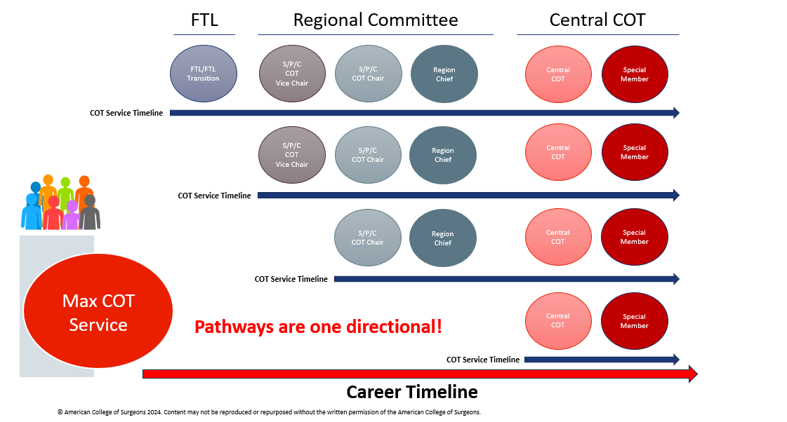
Pathways to Participation - ONE Directional
Notes:
This simply illustrates MAX COT Service timeline based on your portal of entry
1. It is possible to serve in the COT over 30 years – which in the eyes of the COT is ideal
Again, pathways are one directional – no going back (except only in extreme circumstances)

Slide 15
Resident and Fellow Trauma Paper Competition – – Looking ahead at the 2025 Competition
Manuscript will be considered part of the final winner selection annually in March.
Prizes to be awarded for the overall First, Second, and Third Place Winners (regardless of classification as either basic science or clinical research paper)
Prize for “Achieving Excellence in Surgery through Equity” (of submitted papers)
For detailed information on next year’s competition, please refer to the
Resident and Fellow Trauma Paper Competition website
https://www.facs.org/quality-programs/trauma/committee-on-trauma/trauma-paperscompetition/

Slide 16
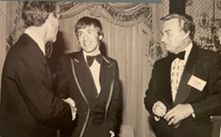
2025 Resident and Fellow Trauma Paper
Competition Updates
Regional submission deadline - December 5, 2024
Judging for final Central competition– 3rd week in December
Full manuscript due- February 1, 2025
Prize Structure:
  Overall, first prize $1,000
  Overall, second prize $750
  Overall, third prize $250
  Achieving Excellence in Surgery through Equity prize $1,000
1977 Resident Paper Competition begins
1978 First Winner Dr John Weigelt; Runner up Mary McGrath

Slide 17
Achieving Excellence in Surgery through Equity prize.
The prize will go to the research paper that best addresses key issues around diversity, equity, and inclusion.
Research presented at the final COT Central competition will be eligible if it fits into one of the following categories:
  Addresses inequities in access to trauma care or diagnosis/management of trauma-related conditions
  Investigates heterogeneity of treatment effect among diverse populations
  Describes how social determinants of health are associated with or can affect trauma-related outcomes
  Provides data for interventions that address disparities/ promote equity in trauma care
  Discusses interventions to modify social determinants of health
  Describes issues related to diversity and equity in the trauma work force and leadership
  Explores interventions to reduce disparities in the trauma work force and leadership

Slide 18
Achieving Excellence in Surgery through Equity prize.
The criteria that will be used to judge the equity prize manuscript will include:
  Significance:
    Provides rationale for the significance of the research in the context of just and equitable trauma care
    Reports novel results and/or innovative solutions to address known disparities
  Methodology:
    Is hypothesis-driven
    Uses appropriate research methodology for the research question
  Interpretation and conclusions:
    Has conclusions that are supported by the results
    Has a direct impact on outcomes

Slide 19
THANK YOU – 2024 Discussants:
Galinos Barmparas, MD, FACS
David P. Blake, MD, MPH, FACS
Stephanie Bonne, MD, FACS
Juan C. Duchesne, MD, FACS
Thomas K. Duncan, DO, FACS
Brian J. Eastridge, MD, FACS
Raymond Fang, MD, FACS
Peter E. Fischer, MD, FACS
Naisan Garraway, MD, FACS
Jay A. Johannigman, MD, FACS
Krista L. Kaups, MD, MSc, FACS
Matthew E. Kutcher, MD MS FACS
Stephanie N. Lueckel, MD, FACS
Babak Sarani, MD, FACS, FCCM
Thomas J. Schroeppel, MD, FACS
Douglas J. E. Schuerer, MD, FACS
Kevin M. Schuster, MD, MPH, FACS
Elizabeth N. Turner, MD, FACS

Slide 20
THANK YOU!
2024 Moderators, Editorial Committee and Judges:
Matthew A. Bank, MD, FACS
Ashley Williams, MD, FACS
Raymond Fang, MD, FACS
Jay Johannigman, MD, FACS
Stephanie N. Lueckel, MD, FACS
Thomas J. Schroeppel, MD, FACS
Elizabeth N. Turner, MD, FACS
Naisan Garraway, MD, FACS
Douglas J. E. Schuerer, MD, FACS

Slide 21
THANK YOU!
2024 Equity Award Judges:
Lillian Kao, MD, MS, FACS
Stephanie Bonne, MD, MPH, FACS
Kim Joseph, MD, FACS
Andrew Bernard, MD, FACS

Slide 22





Region 13 Spotlight
Travis M. Polk, MD, FACS
CAPT, MC, USN
Region 13 Chief

Slide 23








Military Trauma Ecosystem
ACS COT

Slide 24
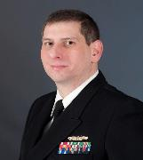
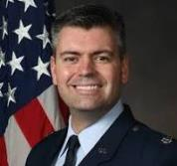
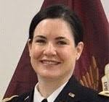
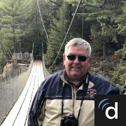
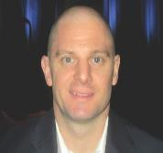

Region 13 Leadership
REGION 13 CHIEF
CAPT Travis Polk
ARMY
COL Jennifer Gurney
(VC: Dilday, Hofman, Becker, Graybill, Gamble, Hathaway, Hardin)
NAVY
CAPT Matthew Bradley
(VC: Tadlock, Jensen, Fitch)
AIR FORCE
Col Brian Gavitt
(VC: How, Russo, Feldt, Stuever, DeSoucy)
VETERANS AFFAIRS
Dr. W. Brian Perry
CANADIAN
ARMED FORCES
Lt Col. Jean Philip Dawe

Slide 25

Military Future Trauma Leaders
Margaret Morgan (2017)
Kyle Remick (2017)
Brian Beldowicz (2018)
Rachel Russo (2022)
Emily Hathaway (2022-2023)
Mary Stuever (2024)

Slide 26
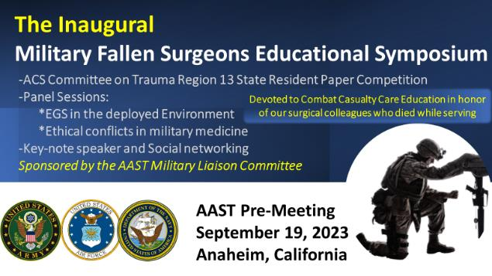
Resident and Fellow Trauma Paper Competition
Army, Navy, and Air Force State Competitions- AAST
(18 papers)
Region 13 Competition- ACS Clinical Congress (7 papers)
Winner: Capt Kelly Harrell, USAF
From Brothers to Heroes in Arms: Expanding Walking Blood Banks to include Women leading to the Potential for More Lives Saved

Slide 27


ATLS
Core component of trauma readiness – required for all providers. Military specific content in development for 11th edition
36 active sites
166 courses since 2/2023

Slide 28
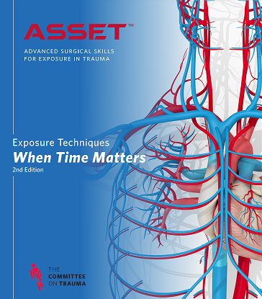
ASSET+
2-day course – Required for all military general surgeons every 3 years
  1: 1 Faculty to Student Ratio
  Formative and Summative Assessment using structured tool
  Additional skills familiarization-
    Lateral canthotomy, C-section, Decompressive craniotomy, amputation, external fixation

Slide 29


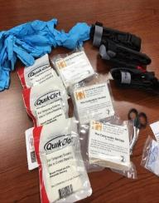
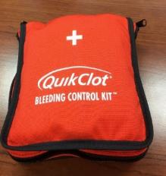

STOP THE BLEED PROGRAM
MORE THAN
PARTNERS IN:
50
DOD LICENSING of STOP THE BLEED LOGO
CCCRP continues to license logo for
Use in educational and public awareness efforts
placement on appropriate products included in bleeding control kits.
400
U.S. STATES
AND ALL U.S. TERRITORIES
LICENSED EDUCATIONAL PARTNERS
PARTNERS IN:
BELGIUM, CANADA, AUSTRALIA & THE U.K and 114 other countries

Slide 30
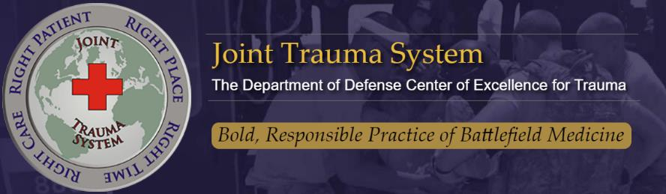
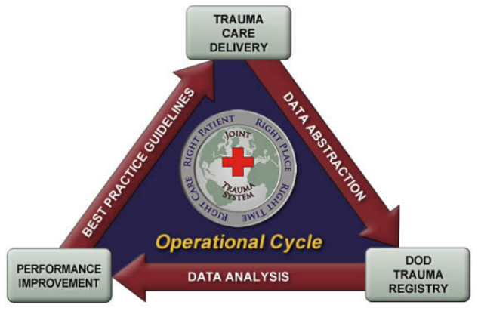

Defense Committees on Trauma

Slide 31

Trauma System Support and Consultation Branch
Assess optimal trauma center level for military treatment facilities (MTF)
Perform a gap analysis to assess what is required to elevate an MTF from current state to desired state
Mentor Trauma Medical Directors/ Trauma Program Managers
Guide the development of the MTFs Performance Improvement Program
Guide the MTF use of the Department of Defense Trauma Registry
Advise the MTF on staffing requirements to meet verification standards
Mock trauma survey in advance of form survey by the ACS
Advise optimal plan for local and regional trauma systems
Assess existing local and regional trauma systems
Mentor leaders in development of combatant command trauma systems

Slide 32
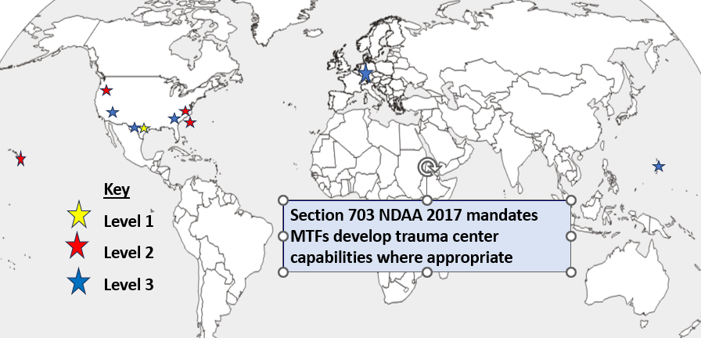
Military Trauma Centers

Slide 33

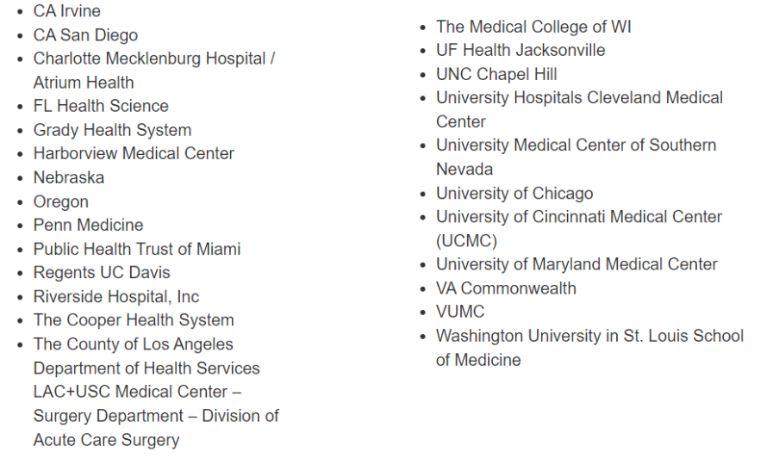
Military- Civilian Partnerships
Mission Zero Act Grant Awardees

Slide 34





National Trauma Research Repository
Incorporation into FITBIR underway
CDEs under development
Partnership effort between DoD, NIH and Coalition for National Trauma Research (CNTR)
Available in late 2024
TBI
TBI
+
Trauma
Polytrauma
https://ntrr-nti.org/
https://fitbir.nih.gov/

Slide 35

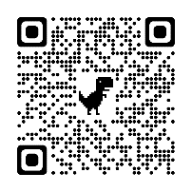
Linking Investigation in Trauma & Emergency Services
Mission: To create a research network of US trauma systems and centers with the capability to conduct prospective, multicenter, injury care and outcomes research of relevance to the Department of Defense.
Epidemiology of trauma in US / mortality analysis
Shock, whole blood and TBI (SWAT) -- Component vs whole Blood; Hemorrhagic shock (HS) and HS+ Traumatic Brian Injury (TBI)
Prehospital Airway Control Trial (PACT)—standard practice vs supraglottic airway
Cold Stored Platelet Early Intervention (CriSP-HS and CriSP-TBI)
Prehospital Analgesia Intervention (PAIN) – IV fentanyl vs ketamine
Type O Whole blood and assessment of Age early Resuscitation (TOWAR) -- <14day old vs >14day old
Desuvia Early Evaluation of Pain (DEEP) – standard therapy vs SL sufentanil in injured patients
Calcium and Vasopression in Early Resusitation (CAVALIER)
Over 40 trauma center/ prehospital system sites (lead site--U Pitt)
8 multicenter studies resuscitation, pain, and airway management.

Slide 36
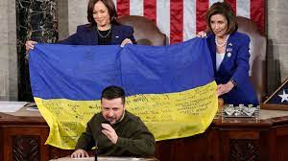
Ukraine partnerships (FY23 National Defense Authorization Act, Section 736)
By February 24, 2023, the Secretary of Defense shall seek to enter into a partnership with the appropriate counterpart from the Government of Ukraine for the establishment of a joint program on military trauma care and research, consisting of:
Sharing lessons learned from the Russo-Ukraine War
Joint conferences and exchanges with military medical professionals from Ukraine and the US
Collaboration with the armed forces of Ukraine on matters relating to health policy, health administration, and medical supplies and equipment, including through knowledge exchanges
Conduct of joint research and development on the health effects of new and emerging weapons
Entrance into agreements with military medical schools of Ukraine and the Uniformed Services University of the Health Sciences for
reciprocal education programs under which students receive specialized military medical instruction
Provision of support to Ukraine for facilitating the establishment of a program substantially similar to the Wounded Warrior Program in Ukraine
Provision of training to the armed forces of Ukraine in the following areas:
  Health matters relating to chemical, biological, radiological, nuclear and explosive weapons
  Preventive medicine and infectious disease
  Post traumatic stress disorder
  Suicide prevention
The maintenance of a list of medical supplies and equipment needed
Such other elements as the Secretary of Defense may determine appropriate

Slide 37
Membership Program Area
Chair, Krista L. Kaups MD, MSC, FACS
incoming Chair – Stephen L. Barnes, MD, FACS

Slide 38
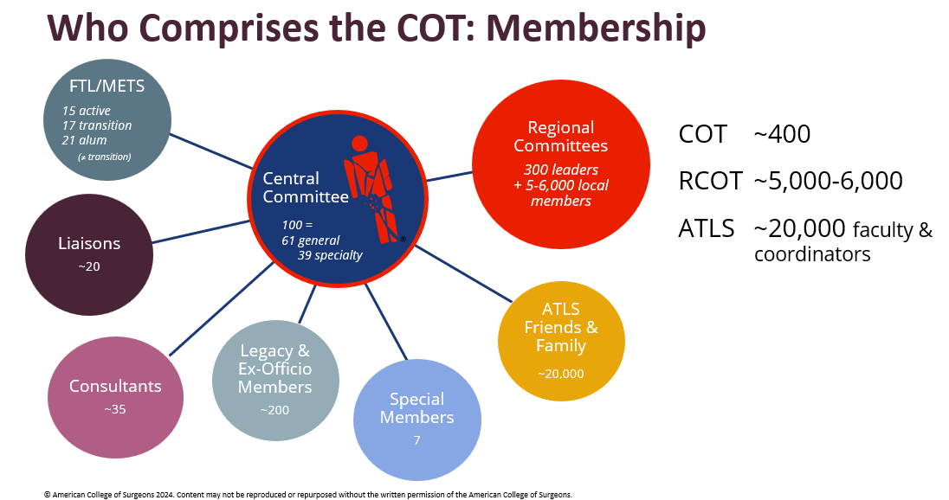
Engagement

Slide 39
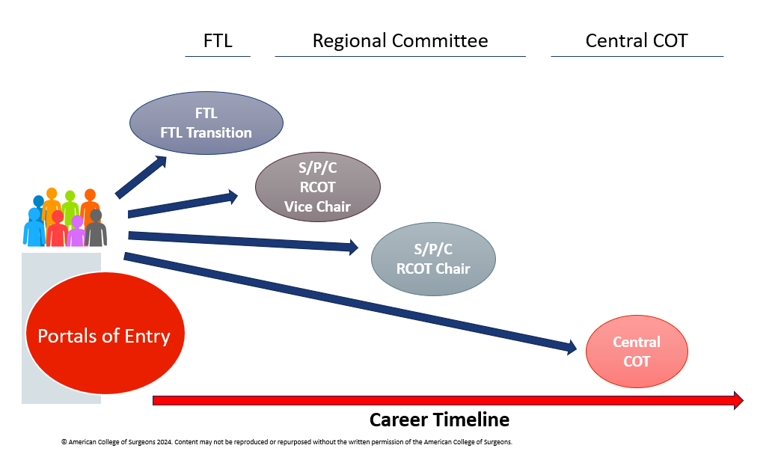
Pathways to Participation is ONE Directional
Notes:
One directional = cannot go back to the regional committee – once done with central you are done

Slide 40
Membership Program Area

Slide 41
Membership Program Area Responsibilities
Mentoring for Excellence in Trauma Surgery (METS)
Future Trauma Leaders (FTL)
Resident and Associate Society (RAS)
Young Fellows Association (YFA)
DEI Advisory Council
Scudder Oration Work Group
(Scudder Selection)
Specialty Surgery Advisory Council
Clinical Scholars
Burn, Neuro, Ortho, Reconstruct, Vascular, OMS, OB/Gyn, Urology
Liaisons and Consultants
Liaison to/from ACS-COT
Federal Partner
Independent Contactor
Review and Selection of Central COT Membership

Slide 42
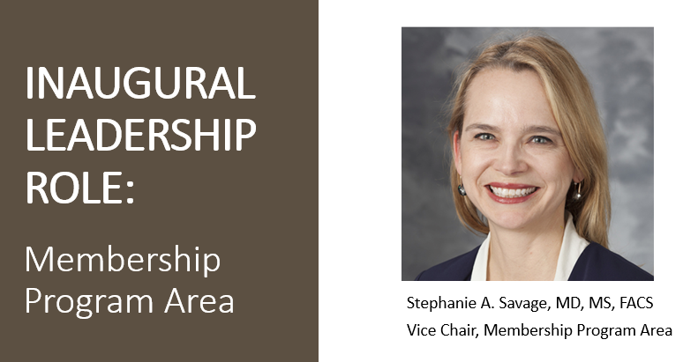
savage@surgery.wisc.edu
Notes:
Email address……

Slide 43
Central Committee
  3yr first term appointment
  Eligible for second 3yr term
  Total Service of 6 years
  Participation is KEY
    Attendance Required (during 3-year terms):
      2 of 3 Spring COT Annual Meetings
      2 of 3 Fall Meetings at the ACS Clinical Congress
      (excused absences for illness/emergencies)
      Register AND Check-in (pick up your badge!)
    Participation in Committee work
      Attend Committee Meetings
      Document activity
Central
Committee
Notes:
Second term not guaranteed – needs to be earned.
2nd term appointment questionnaire – sent in third year/first term
1. You will be asked
a. Which meetings
b. What projects have you worked on
2. Feedback from your Committee Chair

Slide 44
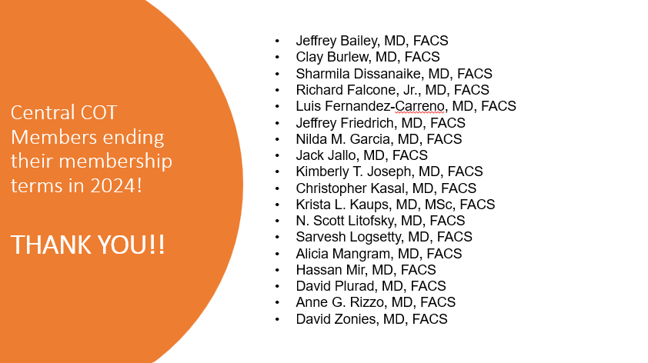
Notes:
Would be very nice (and may already be included at the banquet) to include years of service and positions held on this slide….I agree a collage of photos also nice. (JvH - all included in at the Banquet TY’s)
Thanking folks for service should come with some recognition of the length of service I believe – don’t know if that is achievable with existing COT record/record keeping, just my thoughts.

Slide 45
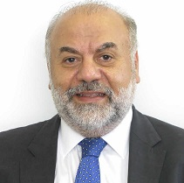
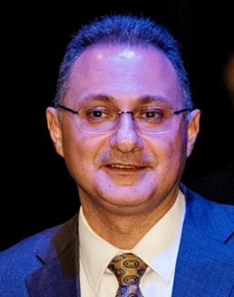
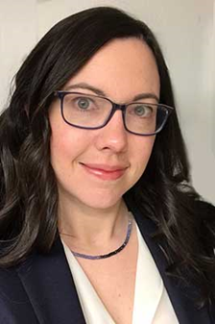
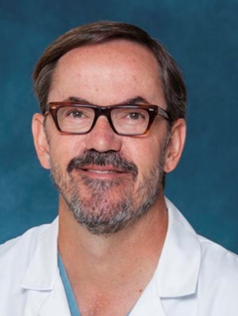
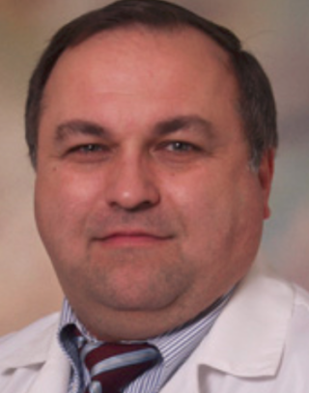
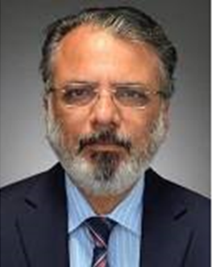
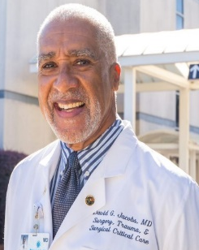
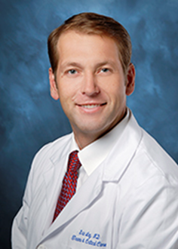
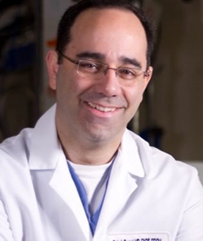
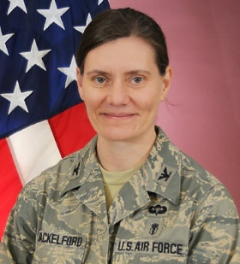
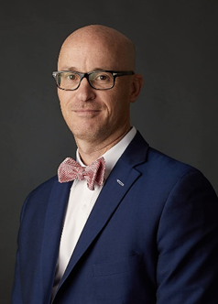
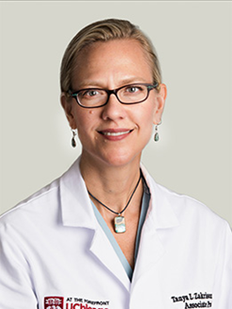
Welcome new Central COT Members
Trauma Surgery
Abi Saad, George S.
Beirut, Lebanon
Arbabi, Saman
Seattle, WA
Bradley, Nori
Vancouver, BC
Brown, Carlos V. Austin, TX
Dumire, Russell Johnstown, PA
Malhotra, Ajai Burlington, VT
Jacobs, David G. Charlotte, NC
Ley, Eric J
Playa Del Rey, CA
Sarani, Babak Washington, DC
Shackelford, Stacy USAFA, CO
Todd, S. Rob Atlanta, GA
Zakrison, Tanya L. Chicago, IL

Slide 46
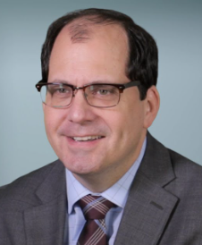
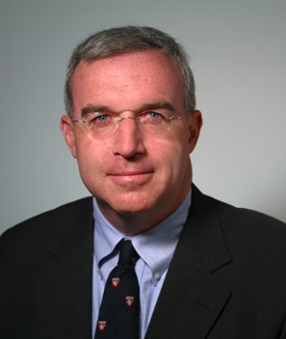
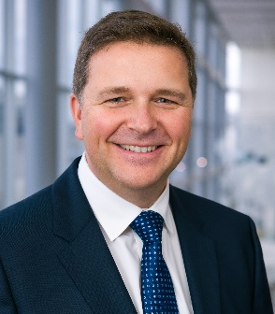
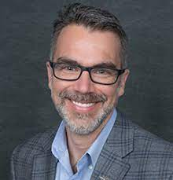
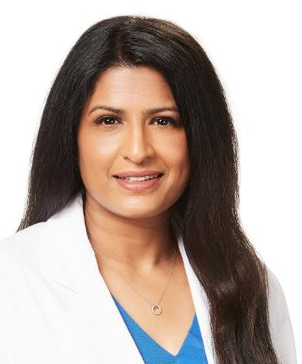
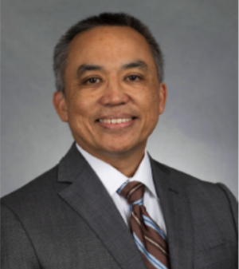

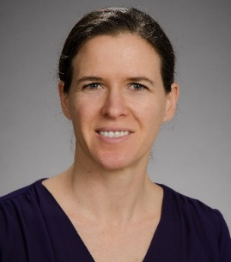
New Central COT Members: Surgical Specialties
Brandes, Steven B. New York, NY Urologic Surgery
Gates, Jonathan Hartford, CT Vascular Surgery
Mandell, Samuel - Dallas, TX
Burn Surgery
Martin, Jonathan E. Hartford, CT
Neurosurgery
Mani, Usha
Dallas, TX
Orthopedic Surgery
Ignacio, Romeo C San Diego, CA
Pediatric Surgery
Levy, Marc
Orlando, FL
Pediatric Surgery
Keys, Kari Anne
Seattle, WA
Reconstructive Surgery

Slide 47

Central Committee Membership Timeline
Online Nominations
Close June 28, 2024
Membership Committee Review
July-August, 2024
Membership Recommendations
  COT Exec & Board of Regents
October 17, 2024
Central Committee Membership Start
Spring COT meeting 2025

Slide 48
METS Program
Mentoring for Excellence in Trauma Surgery
Notes:
Barnes: Would a diagram – much like slide 5 – that showed what all makes up METS and then one slide on each of the METS programs be easier to understand????

Slide 49
Mentoring for Excellence in Trauma Surgery (METS)
Central Committee on Trauma Membership Chair
METS PROGRAM
Mentoring for Excellence in Trauma Surgery
Future Trauma Leaders (FTL)
4 campaign funded positions
1 Military (JTS/MHSSPACS)
1 OTA - every other year
Term: One two-year term – 3-year transition
ACS Young Fellows
Society (YFA)
1 Position
Term: One three-year term
ACS Resident and Associate Society (RAS)
1 Position
Term: One three-year term
Clinical Scholars
1 -2 Positions
Term: 1-3 years

Slide 50
Future Trauma Leaders (FTL) Program:
Established in 2015
Early career exposure to all aspects of the COT
  Education
  Advocacy
  Quality
  Systems
  Prevention
Perspective of early career surgeons to COT projects
Pathway to sustained COT involvement
METS:
Mentoring for Excellence in Trauma Surgery
Notes:
Barnes - The above and below seems to be about the FTL program – METS is hard to understand -
Program established in 2015 by Dr. Bulger
Goal – foster…..
Early career portal of entry into the COT
Win – win for the COT
They get early career exposure
COT benefits from their perspective as young surgeons and energy to multiple projects
Also key to provide pathway for participation
Regional appointment
If not, then FTL transition appointment

Slide 51
Future Trauma Leaders (5-6 / year)
  Junior Surgeons
  Within 5 years of fellowship completion
  Competitive application process
  Two-year term
  Sponsored/Mentored Project
  Travel to COT Annual Meeting
  Travel to COT Meetings at Clinical Congress
  Travel to TQIP Meeting
  Travel to ACS Leadership and Advocacy Summit
  Three-year Transition Period
Liaison Members
  Young Fellows Association (YFA)
  Resident and Associate Society (RAS)
  Clinical Scholars (Quality & Prevention Pillars)
METS:
Mentoring for Excellence in Trauma Surgery
Notes:
Two components to the program:
1. Future Trauma Leaders
a. 4/year
b.
4 per year –
Miliary spot
Every other year othor
1 liaison from yfa and one from ras serve 3 year terms

Slide 52

FTL Timeline
Online Applications
Close July 31, 2024
Membership Committee Review
August-September, 2024
Membership Recommendations
COT Exec & Board of Regents
October 17, 2024
FLT Membership Start
Spring COT meeting 2025

Slide 53






Welcome 2024 Future Trauma Leaders
Robel Beyene, MD
Nashville, TN
Mohammad Hashmi, MD
Birmingham, AL
Kristina Kramer, MD
Springfield, MA
Lacey LaGrone, MD
Fort Collins, CO
Mary Stuever, MD
Landstuhl AFB
Deidre Wyrick, MD
Little Rock, AR
Notes:
Samuel Ross – Carolinas Medical Center
Cherisse Berry – NYU
Chethan Sathya – Cohen Children’s Medical Center – New York
John Scott – University of Michigan
Please

Slide 54

COT Member Opportunity Boards
facs.org
“COT Members Only Resources” section
COT Leadership Opportunity Board
  Systems – Quality – Disaster – VRC – Work Groups
COT Participation Opportunity Board
  Education – Quality – Membership – Advocacy - Liaison
Notes:
Barnes: yes QR code – pause on this slide

Slide 55
COT Membership Committee needs YOU!
COT Participation Opportunity Board
  Call to serve on the Membership Committee
  facs.org – COT members only resource section
  Membership Committee Deliverable(s)
  Recruitment of candidates for COT membership
  Recruitment of candidates for FTL positions
  Recommend annual slate of candidates for Central Committee membership
  Recommend annual slate of qualified candidates for the FTL program
  Oversight and collaboration on membership engagement projects as defined during the Strategic Planning Process.
Notes:
Barnes: yes : different QR code – take you directly to membership committee application
Too many words above for a slide – I would drop the paragraph and just put the bullet points – add a bullet point or two if needed.

Slide 56
Future Trauma Leader Feedback
Galinos Barmparas, MD, FACS

Slide 57
"We suggest an indefinite leave of absence from the FTL program with the plan that you can return to the program at any time once you have recovered. Please do not feel you are giving up on this but rather postponing it for a better time..."

Slide 58

Congratulations!
CLASS OF 2023 (sort of...)

Slide 59
Spotlight Discussion
Dear Dr. Barmparas,
Thank you for submitting a proposal for the Clinical Congress COT Spotlight Discussion series! We received many topics spanning a full spectrum of trauma issues. Your submission has been accepted as follows:
Spotlight Discussion Title: Quantifying Clinical Workload for Trauma Surgeons Within the Acute Care Surgery Model: How Much is Too Much?

Slide 60















ACS Workforce Workgroup

Slide 61
…and added responsibilities…
Other opportunities
AAST MIT Committee
  AAST MIT Survey Subcommittee
AAST Healthcare Economics Committee
AAST Leadership Academy
SoCal ACS Young Surgeons' Representative
SoCal ACS Vice Chair
A few invited talks
Interim SICU and SCC Fellowship Director
Trauma Medical Director
Director of Trauma/EGS Research

Slide 62







Slide 63
Common Themes...
Work, work, work...
Quality care
Improved access
Leadership development...

Slide 64


Slide 65
Advocacy Round Up
John H. Armstrong, MD, FACS
Chair, Advocacy Pillar
2022 SurgeonsVoice Advocate of the Year

Slide 66


Slide 68
ACS Foundation
Future Trauma Leaders
Trauma Global Education Fund
Resident & Fellow Trauma Paper Competition Fund
https://www.facs.org/about-acs/acs-foundation/donate-to-the-acs-foundation/

Slide 69
2024-25 strategies
Building the COT advocacy community
Writing for advocacy
Integrating advocacy in all COT places

Slide 70
Ronald M. Stewart, MD, FACS, a past-Chair of the ACS Committee on Trauma, has said: “At least one-third of Americans today live in an area without a complete trauma system, and tens of thousands of lives are lost unnecessarily each year. This is the most important health problem facing our children.”
With this in mind, the ACS has steadily advocated for a National Trauma and Emergency Preparedness System. The intention is for pediatric patients, as well as all others, to benefit from improved coordination in trauma care.
Patricia Turner, MD, MBA, FACS, ACS Bulletin February 2024

Slide 71
Trauma activation fees
√ Town Hall
□ Draft position statement (March 31)
□ COT feedback
□ COT EC approval
□ BR approval

