Slide 1

Commission on Cancer Hospital Accreditation Status is Associated with Increased Delivery of Guideline-Concordant Care for Highly Vulnerable Patients with Breast Cancer
Kelley Chan MD, MS

Slide 2
Background
Receipt of guideline-concordant care (GCC) is associated with improved survival for patients with breast cancer
Disparities in receipt of GCC have been reported due to patient sociodemographic and hospital characteristics
Objective: Evaluate the association of social vulnerability with receipt of GCC among patients with breast cancer

Slide 3
Methods
National Program of Cancer Registries (NPCR) and Surveillance, Epidemiology, and End Results (SEER) Program Database
2020 CDC Social Vulnerability Index (SVI) at the county level
Chi squared statistics to compare SVI cohorts
Multivariable logistic regression models investigated the association of SVI with receipt of GCC
  SVI*Hospital accreditation status interaction term

Slide 4
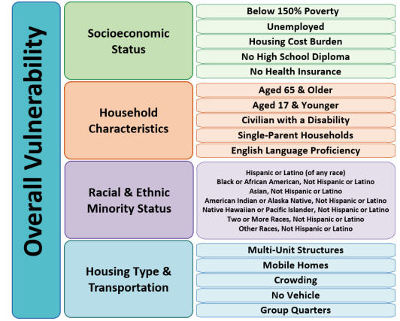
Social Vulnerability Index
SVI ranges from 0 to 100
  0 indicates least vulnerable
  100 indicates most vulnerable
Evaluated as continuous and categorical (quartiles)
  Lowest quartile as low vulnerability
  Middle 2 quartiles as average vulnerability
  Highest quartile as high vulnerability

Slide 5
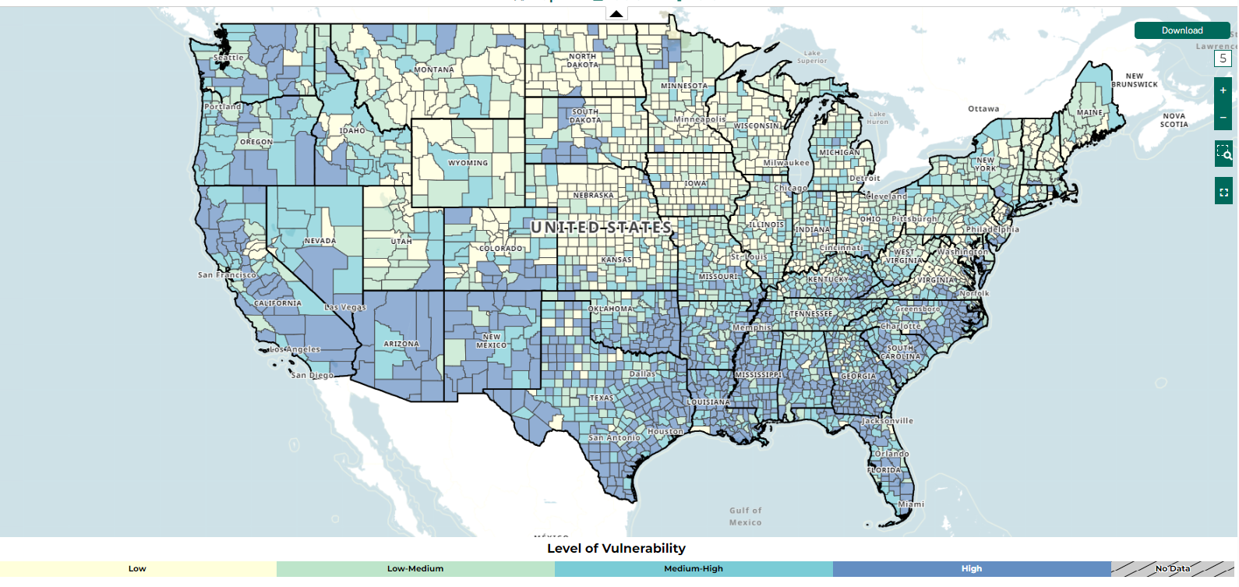

Slide 6
Guideline-Concordant Care Definitions
Therapeutic breast surgery for stage I-III
Radiation therapy after breast conserving surgery for stage I-III
Combination chemotherapy or chemoimmunotherapy recommended or administered for patients with HER2+ or triple negative for N>0 or T≥2
Endocrine therapy initiated for ER+ or PR+ stage I-III

Slide 7
Patient Sociodemographic Characteristics
448,104 patients
Median SVI 58.0 (IQR 32.3 to 78.3)
 | Low SVI, N = 87,865 n (%) | High SVI, N = 86,648 n (%)
Median SVI (IQR) | 21.4 (13.7-27.0) | 87.4 (80.1-91.2)
Non-Hispanic White | 97,195 (86.4) | 57,131 (51.7)
Uninsured | 1,333 (1.2) | 3905 (3.5)
Regional lymph node involvement | 30,074 (26.7) | 34,190 (30.9)
Treated at CoC-accredited hospitals | 92, 093 (81.9) | 86,164 (77.9)

Slide 8
Receipt of Guideline-Concordant Care
Receipt of Guideline-Concordant Care | Low SVI, n (%) | High SVI, n (%) | p-value
Breast surgery | 88,621 (96.0) | 80,884 (91.7) | <0.001
Radiation therapy after BCT | 39,395 (89.5) | 30,159 (78.0) | <0.001
Combination chemotherapy or immunotherapy | 12,411 (94.7) | 13,618 (88.2) | <0.001
Endocrine therapy | 79,498 (89.1) | 61,990 (76.2) | <0.001

Slide 9
Multivariable adjusted odds ratio for receipt of GCC
Variable | Group | Receipt of GCC, OR (95% CI) | p-value
Social Vulnerability Index
 | Low | 1.46 (1.42 – 1.50) | <0.001
 | Average | Ref.
 | High | 0.64 (0.63 – 0.66) | <0.001
Race and ethnicity
 | NH White | Ref.
 | NH Black | 0.85 (0.82 – 0.87) | 0.016
 | Hispanic (All Races) | 0.68 (0.66 – 0.70) | <0.001
Insurance status
 | Uninsured | 0.97 (0.90 – 1.03) | 0.051
 | Private Insurance | 1.07 (1.03 – 1.10) | <0.001
 | Medicaid | Ref.
CoC-Accreditation
 | Non-CoC-Accredited | Ref.
 | CoC-Accredited | 2.62 (2.56 – 2.67) | <0.001

Slide 10
Receipt of GCC in high SVI subtheme groups
Social Vulnerability Subtheme | Receipt of Guideline-Concordant Care, OR (95% CI) | p-value
Socioeconomic status | 0.45 (0.43 – 0.47) | <0.001
Household characteristics | 0.81 (0.78 – 0.84) | <0.001
Racial and ethnic minority status | 0.59 (0.57 – 0.61) | <0.001
Housing type and transportation | 1.61 (1.56 – 1.66) | <0.001

Slide 11
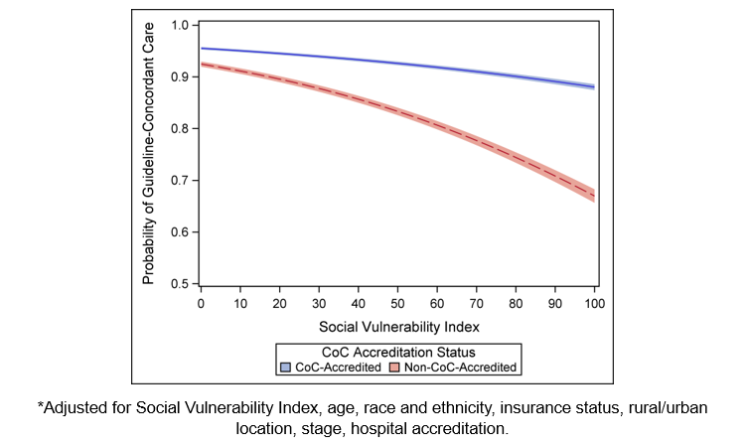
Association between SVI and adjusted probability of receiving GCC by CoC accreditation status

Slide 12
Limitations
Unavailability of data on:
  Patient comorbidities
  Hospital type or volume
  Treatment dates
Recognition of patients who received part of their treatment at a different hospital was not available
SVI is not cancer-specific

Slide 13
Conclusions
Receipt of GCC was lower for patients from highly vulnerable communities
Disparities most prominent in communities with higher vulnerability in socioeconomic status and racial and ethnic minority status
As SVI increased, treatment at CoC-accredited hospitals, compared to non-CoC-accredited hospitals, was associated with increased likelihood of GCC
  May reflect CoC requirements for community outreach and addressing barriers to care

Slide 14
Thank You!

