Slide 1
What a Coordinator Needs to Know about the 11th Edition

Slide 2
Disclosures
Speaker(s) have no financial or other disclosures

Slide 3
Who is here? From Where?

Slide 4
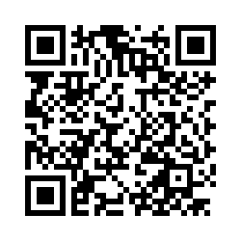
Questions Encouraged!

Slide 5
Overview
Content Reorganization
Manual
Interactive Discussions
Hybrid Course Modules
Skills Training
Assessment scenarios
MCQ
Timeline for Pilots and Launch
Refresher / Instructor
11th Edition!

Slide 6
Content Reorganization
Treat the greatest threat to life first: ABCDE xABCDE
New / Expanded Content
Team Communication
Triage and Disaster Management
Injury Prevention
Trauma Informed Care / Social Determinants of Health
Communicating Serious News
Penetrating Trauma

Slide 7
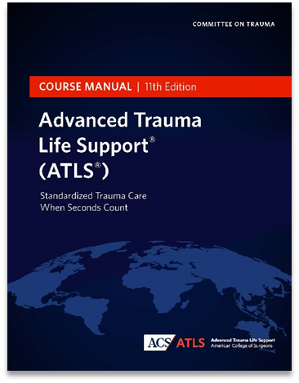
Course Manual
Removed appendices
Interactive Discussions and Hybrid Modules are the same.
Manual has three sections:
Evaluation, Management, and Resuscitation of the Injured Patient
Trauma Systems and Patient Centered Care
Specific Injuries and Injury Patterns – Special Considerations

Slide 8
Course Manual: Section 1

Slide 9
Course Manual: Section 2

Slide 10
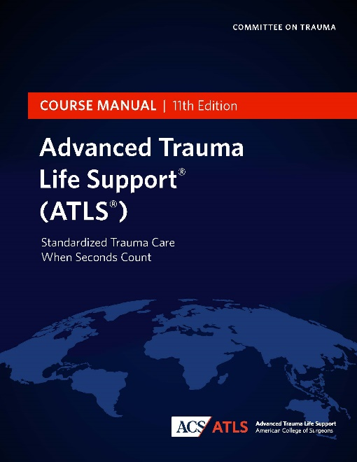
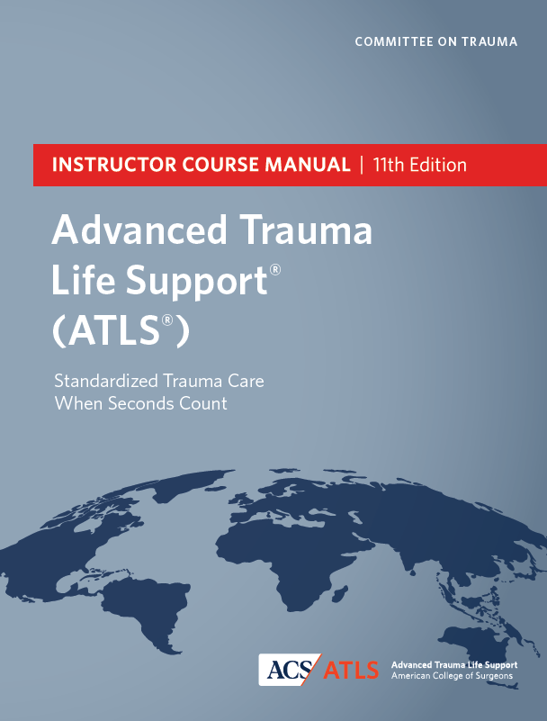
Manuals
Course
Faculty
Policy
Instructor Course
Refresher Course

Slide 11
Interactive Discussions
16 All new slide sets
Extensive instructor notes / guides
Optional advanced material
Optional specialty material
Weave concept (covered tomorrow)

Slide 12
Hybrid Course Modules
24 all new modules (mandatory and elective)
All new instructional design creations
Compatible with learning management system
Match in person Interactive Discussions, with some added optional modules

Slide 13
Skills Stations
Initial Assessment/Pretest Review
Airway Management
Breathing/Surgical Airway
Circulation
Disability
Secondary Survey
Communication
Triage/Adjuncts

Slide 14
Skills Stations
Slide deck format
Curriculum, equipment, options
Extensive printable notes
When and how to use stepwise training
Maintained ABCDE organization
Skill options based on practice environment

Slide 15
Skills Stations
Selected skill practice will be conducted using the multi-step model for teaching psychomotor skills (know, see, hear, say, do, review).
Pre-course video review accomplished the “know”, “see”, and “hear” steps.
Therefore, the Instructor starts at the “say” step by facilitating the learners to narrate the procedure while the instructor either performs a live demonstration or shows selected portions of the 2.5 minute video (embedded above) with sound off.
Next, each learner practices the skill (“do”) with other learners narrating (if they have not yet done so), accompanied by Instructor feedback (“review”).

Slide 16
Skills Stations: Learning Lab
Initial Assessment/Pretest Review
Airway Management
Breathing/Surgical Airway
Circulation
Disability
Secondary Survey
Communication
Triage/Adjuncts

Slide 17
Videos
Motor Skills:
Bag-Valve Mask
Orotracheal Intubation / LMA
Surgical Airway (manikin/cadaver)
Finger and Tube Thoracostomy
Tourniquet Application
IO Insertion
Pelvic Stabilization (sheet/commercial device)
Cognitive Skills:
Primary Survey
Team Dynamics
Neurologic Exam
Trauma Informed Care
Communicating Serious News
Evaluation CXR, PXR, FAST
Notes:
Some will be mandatory pre course – not sure which those are yet.

Slide 18
Initial Assessment Scenarios
Edited scenarios for 11th edition
Weave elements added
Global review of materials
New quick reference guides
ATLS concepts
Setting / Personnel
Injuries / MIST / Patient Course
Additional flow chart format

Slide 19
MCQ Exams
Extensive exam revision by MCQ workgroup
Four 40 question tests complete:
1 pretest –still online
3 post tests

Slide 20
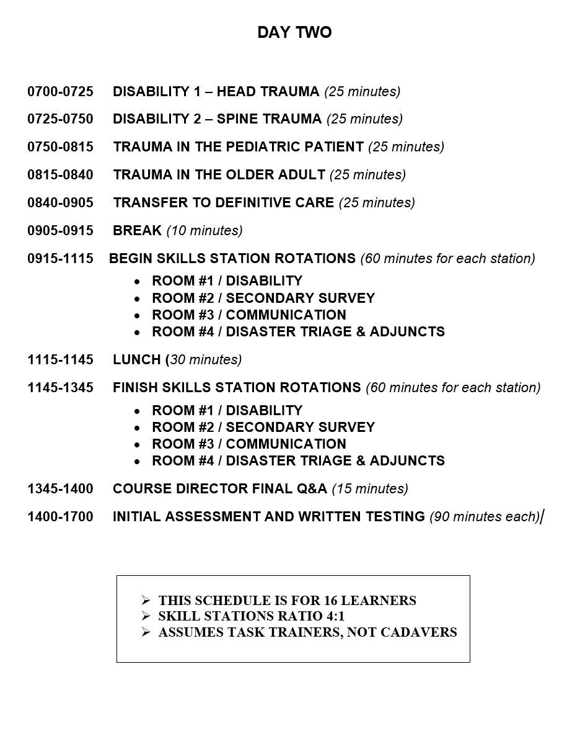
Class Schedule: Traditional

Slide 21
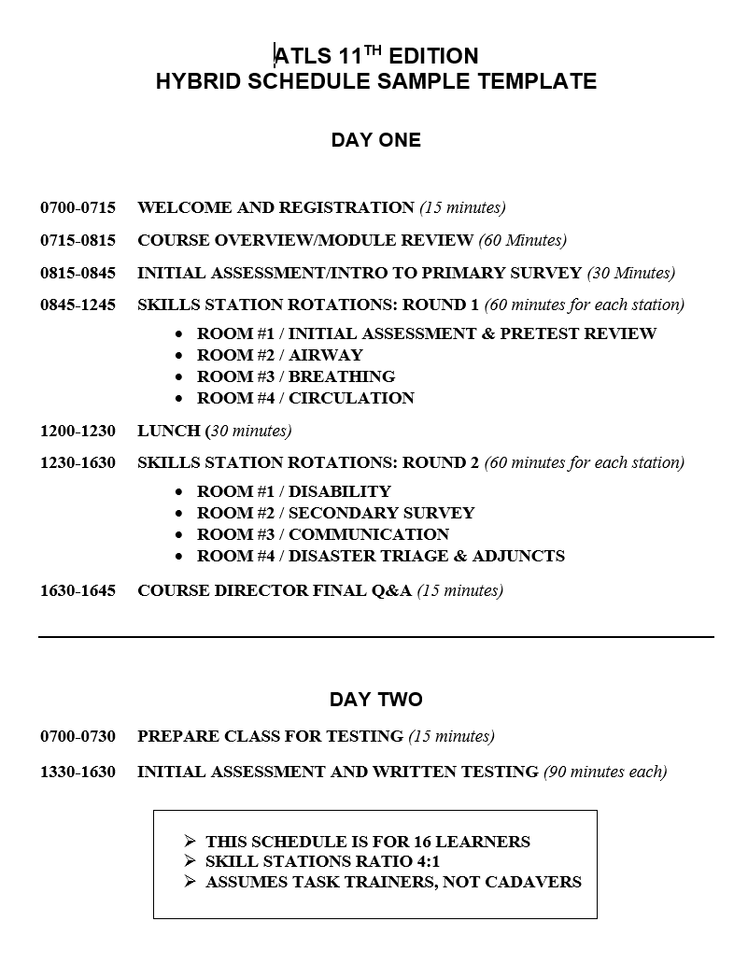
Class Schedule: Hybrid

Slide 22
Launch Timeline
Traditional Course pilots start April
Hybrid pilots June – July
Traditional Course Launch- August
Multilingual at launch
Hybrid launch by Fall

Slide 23
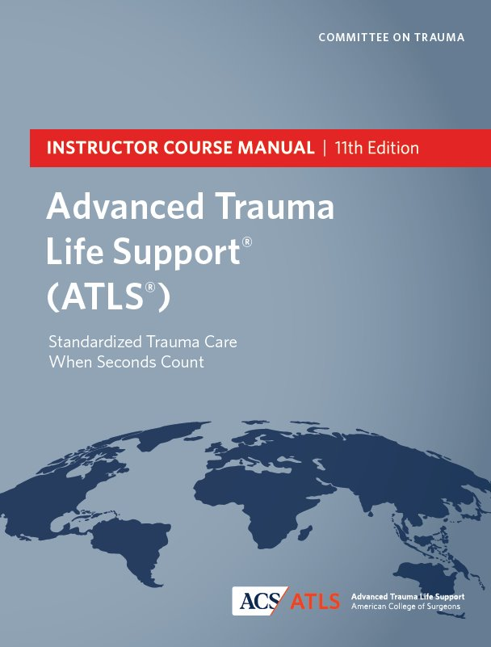
Other Courses
Refresher
Instructor

Slide 24
Jimm Dodd, Senior Manager, Stop the Bleed Program

Slide 25
Questions Encouraged!

