Slide 1
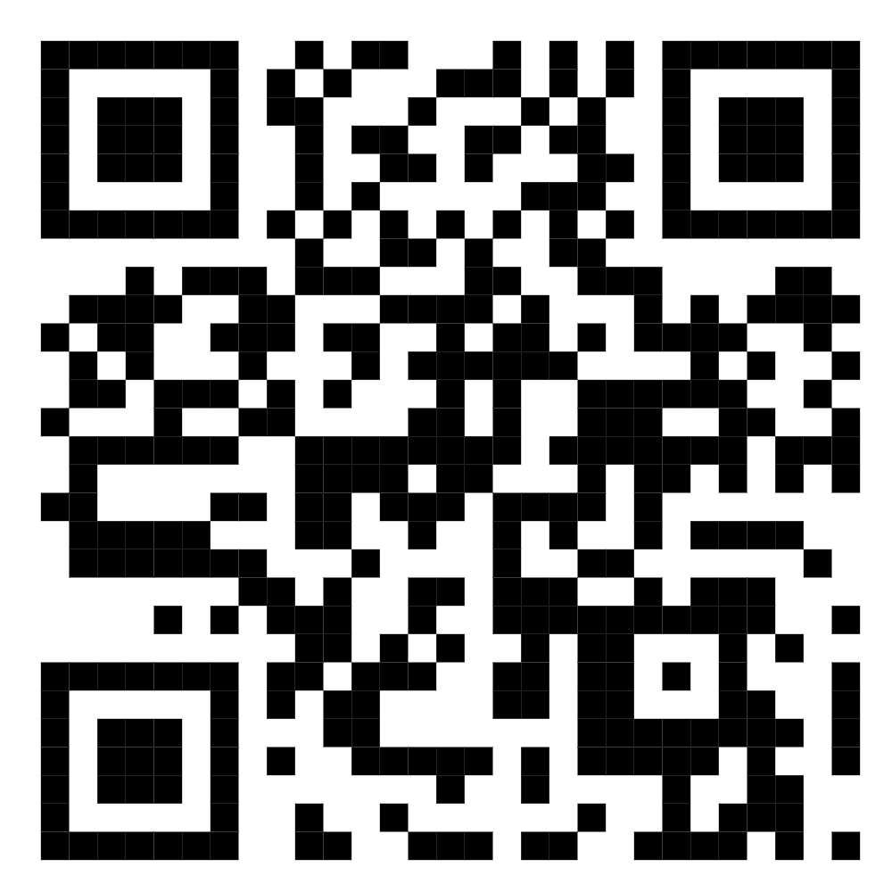
The Lived Experience of Family Cancer Caregivers: The Impact of Supportive Services on the Caregiver
Dr. Amy Halter, PH.D., LPC Indiana University of PA, Dept. of Counseling
Introduction:
With the increase in new cancer diagnoses, the family caregiver will be called upon to support their loved one in their cancer journey. The caregiver experiences negative impacts & extensive burden as a result, is often invisible to the healthcare team.
Results:
Six themes were identified: Impact of daily life, challenges of being a caregiver, feelings of guilt, patient relationship, need for support & support services.
Need for support from healthcare: Caregivers felt invisible during appointments, detailed being asked to complete medical tasks they felt unqualified to do, and the medical team never asked how the caregiver was coping.
Results showed when the caregiver is healthy the cancer patient attends appointments, follow-ups and the caregiver attends to their care.
Conclusions:
There is not enough attention given to the caregivers. Resources were only provided to the patient and rarely to the caregiver. The important conclusion is the need to develop a caregiver assessment based on the Indivisible Self Model to be utilized during the patient appointments with the caregiver.
Materials and Methods:
Qualitative research study
Utilized interviews, recordings & memos
Interviewed 9 family cancer caregivers via Zoom.
Literature Cited:
Myers, J.E., & Sweeney, T. (2005). Five Factor Wellness Inventory.
Siegel, R., Miller, K., Fucgs, H., & Jemal, A. (2022). Cancer statistics. CA: A Cancer Journal for Clinicians, 72(1), 7-33. https://doi.org/10.3322/caac.21708
Acknowledgements:
I would like to sincerely thank my research participants and all family cancer caregivers who are supporting their loved ones. My research is a result of my dad battling head and neck cancer. I admire his courage and spirit.

