Slide 1
SURVIVAL AFTER RECTAL CANCER RESECTION IS ASSOCIATED WITH TEXTBOOK OUTCOME BUT NOT SURGICAL CASE VOLUME
Mohamed Aly MD, Yu-hui chang PhD, Chee-Chee Stucky MD, Zhi Ven Fong MD, David Etzioni MD MS, Nabil Wasif MD MPH
Department of Surgery
Division of Surgical Oncology
Mayo Clinic Arizona

Slide 2
No conflicts of interest to declare
Disclosures

Slide 3
BACKGROUND
Textbook outcome is a quality metric representing the ideal result following complex cancer surgery
Analyzed textbook outcome of rectal cancer surgery and its association with long-term survival
Investigated association of case volume with long-term survival when controlling textbook outcome

Slide 4
Textbook outcome definition
Textbook outcome is achieved with:
Adequate LN count (≥12)
Negative margins (R0 resection)
Length of hospital stay <75th percentile
Absence of 30-day readmission/mortality event
Appropriate and timely systemic therapy

Slide 5
Surgical resection for rectal cancer following textbook outcome has a stronger association with long-term survival than surgical case volume
Hypothesis

Slide 6
Data Source
National Cancer Database (NCDB)
Patients undergoing curative surgery for rectal adenocarcinoma
2014-2015

Slide 7
Statistics
Hospital strata were defined by quartile cut-offs (low <25th, high >75th and medium 25th-75th)
Adjusted analyses for long-term survival were performed using multivariable Cox regression model
Kaplan-Meier curves utilized to demonstrate survival probabilities

Slide 8
RESULTS
Total of 1090 hospitals and 14,841 patients
Textbook outcome was achieved in 28.3% of patients
LV and MV hospital patients were more likely to be Black, uninsured/Medicaid
LV and MV hospital patients were less likely to achieve TO (HV 33.0% vs. MV 28.7% vs. LV 23.3%)

Slide 9
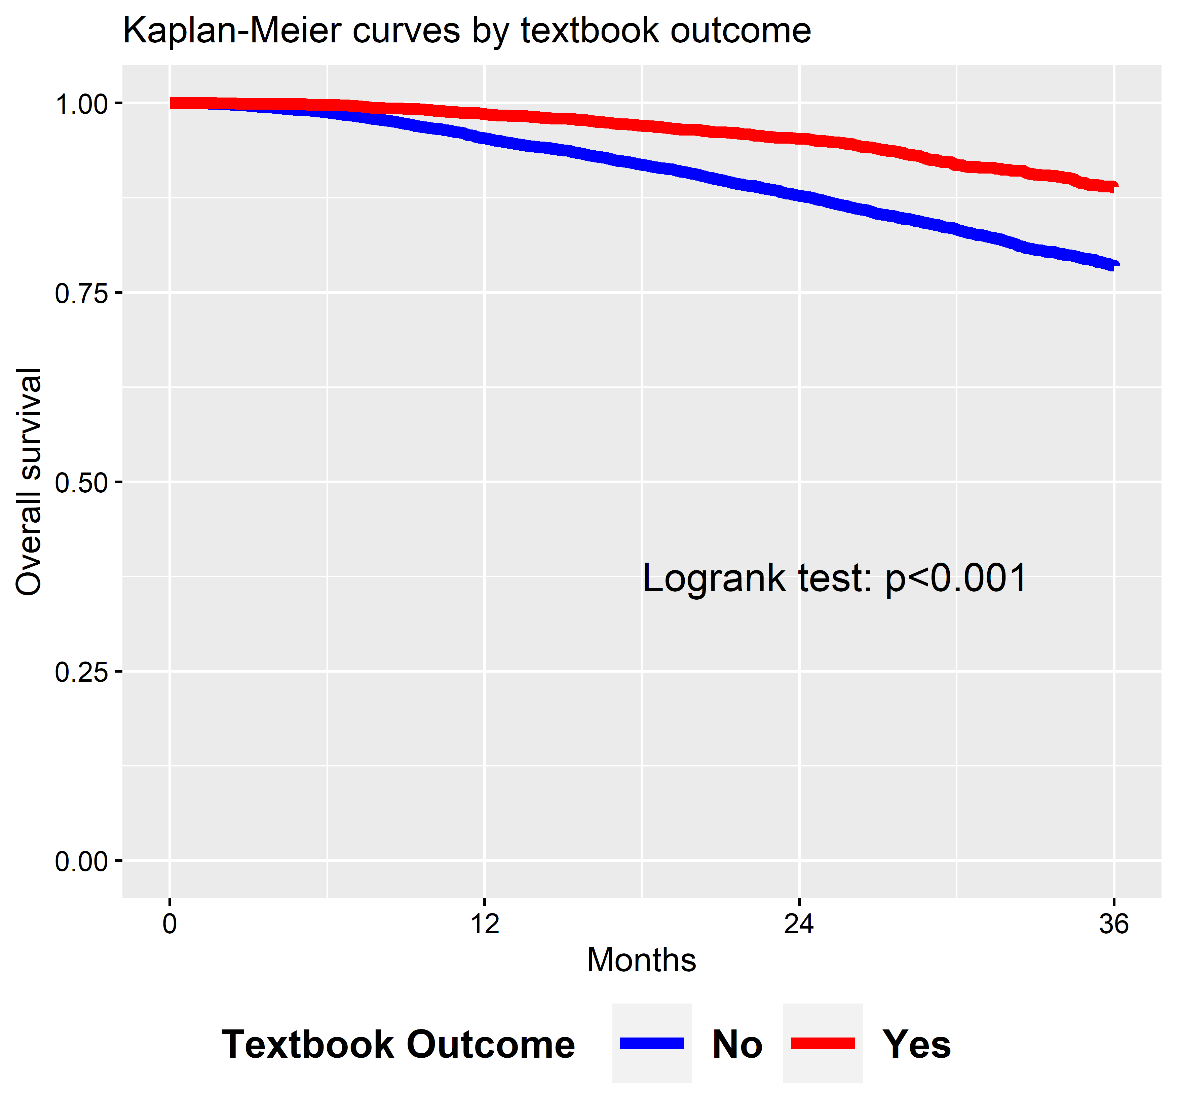
Kaplan-meier curve by textbook outcome
(n=14639 after excluding 202 patient died within 30 days after diagnosis)
©2023 Mayo Foundation for Medical Education and Research | slide-9

Slide 10
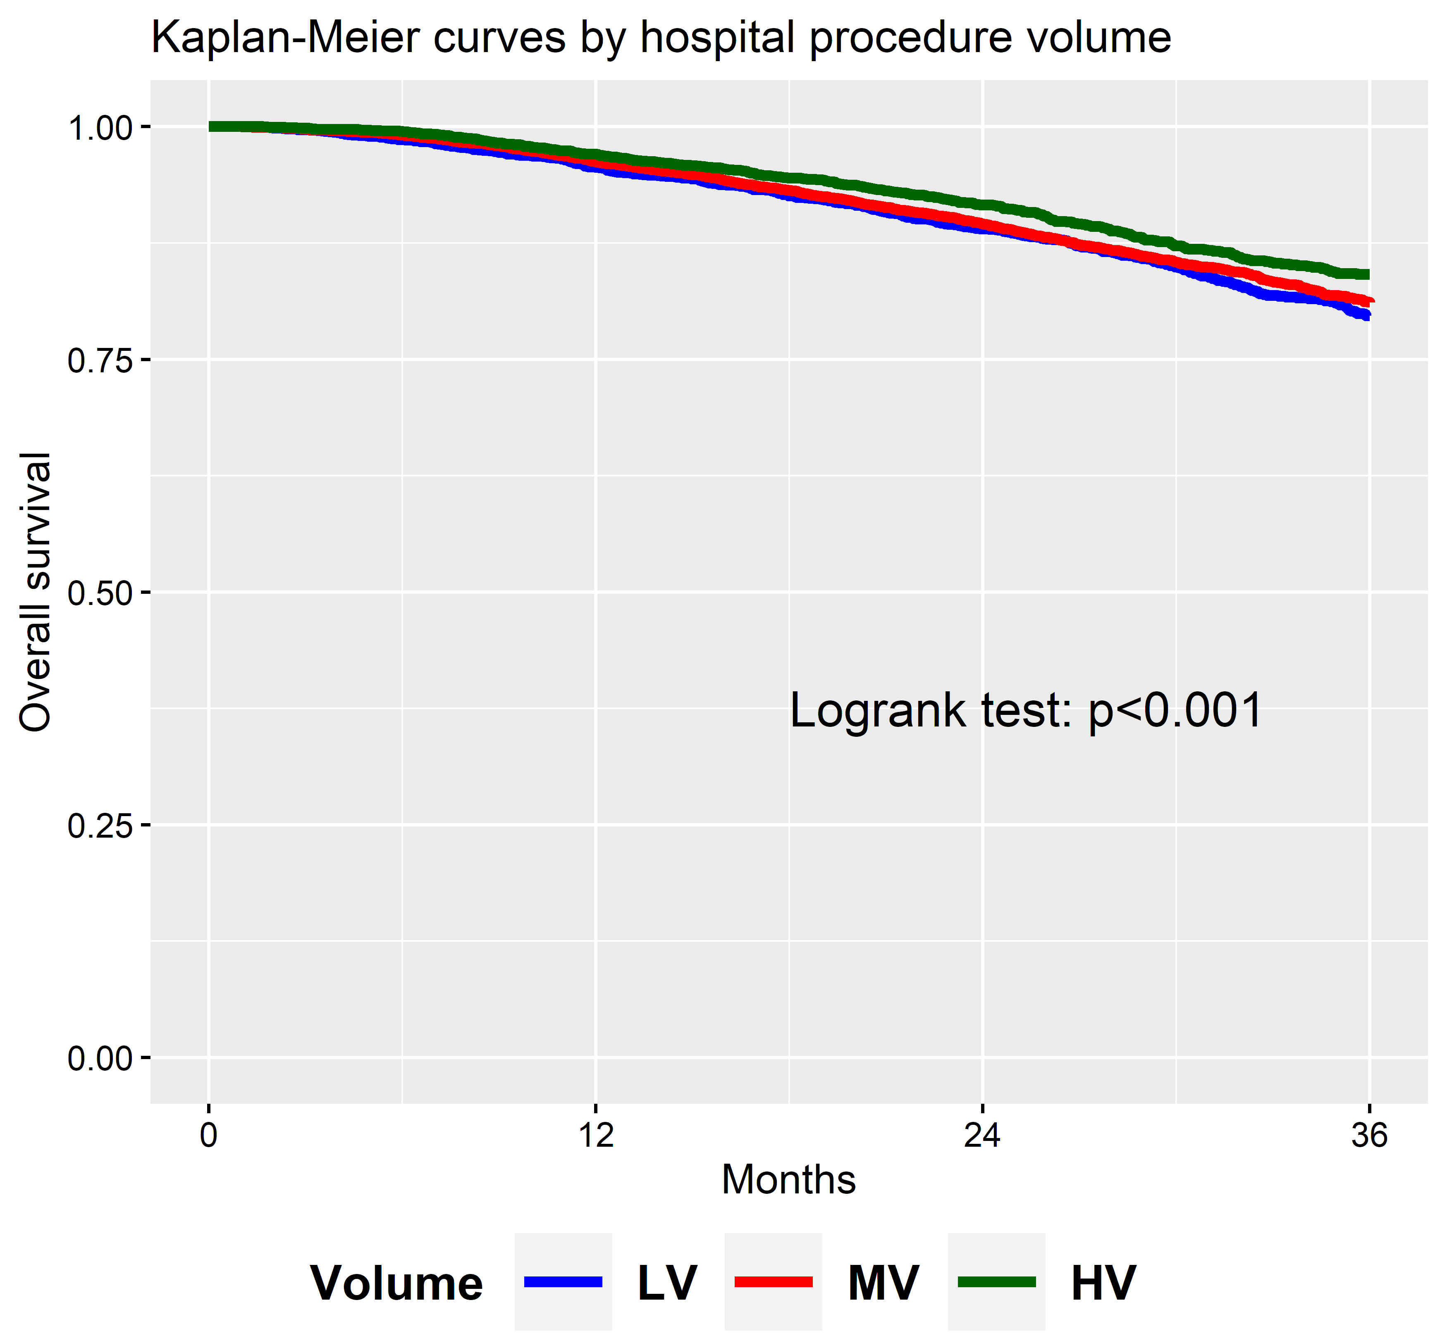
Kaplan-meier curve by hospital volume (LV/mv/hv)
©2023 Mayo Foundation for Medical Education and Research | slide-10

Slide 11
Multi-level cox model
Two models were created: one without the textbook outcome (Model A), and one with textbook outcome (Model B)
Controlled for age, sex, race, insurance, income, education, Charlson co-morbidity and type of surgery

Slide 12
Multi-level cox model
Comparison | Model A (without Textbook Outcome)
 | HR | 95% CI |  | p-value
MV vs. LV | 0.93 | 0.82 | 1.05 | 0.25
HV vs. LV | 0.85 | 0.71 | 1.01 | 0.06

Slide 13
Multi-level cox model
Variable | Comparison | Model B (with Textbook Outcome)
Volume |  | HR | 95% CI |  | p-value
 | MV vs. LV | 0.95 | 0.84 | 1.08 | 0.43
 | HV vs. LV | 0.87 | 0.73 | 1.03 | 0.11
TO | Yes vs. No | 0.56 | 0.47 | 0.65 | <0.001

Slide 14
CONCLUSIONS
Only 28.3% patients achieved textbook outcome when undergoing resection for rectal cancer
Patients who achieved textbook outcome had 44% less risk of long-term mortality independent of hospital volume
Optimizing long-term survival in patients with rectal cancer can be achieved by textbook outcome criteria rather than merely focusing on increasing surgical case volume

Slide 15
ACKNOWLEDGMENTS

